Slide 1
机制设计
Pinyan Lu (陆品燕)
理论计算机科学研究中心(ITCS)
上海财经大学

Slide 2
Mechanism design
New challenges of algorithm design in Competitive Environment:
The designer may not know the input data
The designer may not be able to make sure that the output (allocation) is faithfully implemented

Slide 3
First example
$n$ persons in a room and would like to decide the temperature of the air conditioner.
Each person $i$ has her favorite temperature $t_{i}$.
Mean of ${\{t}_{i}\}$or median of $\{t_{i}\}$?
Which is better?

Slide 4
Truthfulness
3 persons with 25 ℃、26 ℃、27 ℃
Both mean value rule and median value rule will choose 26 ℃
For the mean value rule, the first person may claim her favorite temperature as 22 ℃
Then the mean value is 25 ℃, which is a better result for her.
How about median rule?

Slide 5
Other rules
Majority voting rule
Dictatorship
Strong impossibility results.

Slide 6
Social Choice Theory
Setting:
A : Set of alternatives (“candidates”)
I : Set of n voters
L : Preferences on A ; usually this is the set of total orders on A
Social Welfare Function: f : L^{n} → L
Social Choice Function: f : L^{n} → A

Slide 7
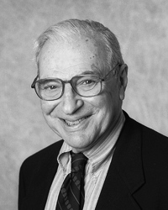
Arrow’s Impossibility Theorem
Theorem [Arrow ’51]
Every social welfare function on a set A of at least 3 alternatives that satisfies Pareto efficiency (PE) and independence of irrelevant alternatives (IIA) is a dictatorship.
Kenneth Arrow

Slide 12
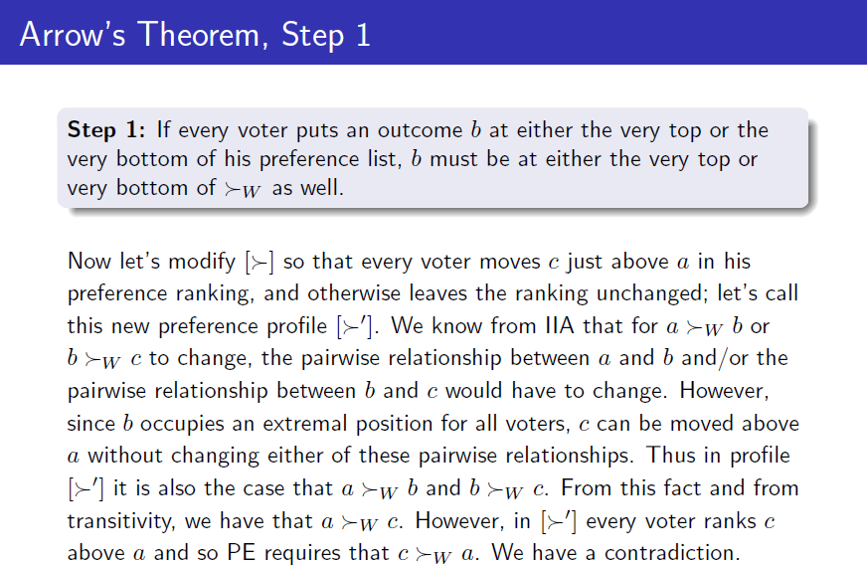

Slide 20
Electing a President
- use a social choice function f
- ideally f should satisfy the following properties:
1. it should not be a dictatorship
Def: A social choice function f is a dictatorship if there exists some voter i such that
f ( <₁, <₂, …,<_{n}) = top( <_{i} ) ;
Such voter i is called the dictator of f.
2. it should not be susceptible to strategic manipulation
Def: f can be strategically manipulated by voter i if there exist preferences <₁, <₂, …, <_{n} and <_{i}’ such that
i.e. i can elect a preferable candidate by lying
f (<₁,…, <_{i}, …, <_{n}) =a <_{i} a’ = f (<₁,…, <_{i}’, …, <_{n})
If f cannot be manipulated it is called incentive compatible.

Slide 21
Monotonicity
Def: f is monotone iff
a’ <_{i} a
f (<₁,…, <_{i}, …, <_{n}) = a ≠ a’ =f (<₁,…, <_{i}’, …, <_{n})
➔
and
a <_{i}’ a’
i.e. if the outcome changes from a to a’ when i changes his vote from >_{i} to >_{i}’, then it must be because the swing voter i also switched his preference from a to a’
Proposition:
(f is incentive compatible) iff (f is monotone)
Proof: Immediate by definition.

Slide 22
Gibbard-Satterthwaite Theorem
Theorem:
If f is an incentive compatible social choice function onto a set of alternatives A, where |A|≥3, then f is a dictatorship.
Remark: “onto” is important; if |A|=2 then the majority function is both incentive compatible and non-dictatorship.
Proof Idea: Suppose f is both incentive compatible and non-dictatorship. Use f to obtain a social welfare function F that satisfies Pareto efficient , independence of irrelevant alternatives and non-dictatorship, which is impossible by Arrow’s theorem.

Slide 23
Proof of the GS theorem
From the social choice function f to a social welfare function F
Notation: If S ⊆ A, and < ∈ L, we denote by <^{S} the preference obtained from < by moving all elements of S to the top of <.
e.g. S = {a, b}, and x < a < y < b < z then x <^{S} y <^{S} z <^{S} a <^{S} b.
Definition of F( <₁, <₂,…, <_{n}) =: <
a < b iff f ( <₁^{{a, b}}, <₂^{{a, b}},…, <_{n}^{{a, b}}) = b
Claim 1: F is a social welfare function.
What can go wrong?
Claim 2: F satisfies PE, IIA, and non-dictatorship.

Slide 24
Proof of the GS theorem (cont.)
Lemma: For any S, <₁, <₂,…, <_{n}, f ( <₁^{S}, <₂^{S},…, <_{n}^{S}) ∈ S.
Proof:
Assume for contradiction that f ( <₁^{S}, <₂^{S},…, <_{n}^{S}) is not in S.
By the onto condition, there exists <‘₁, <‘₂,…, <‘_{n}
such that f ( <‘₁, <‘₂,…, <‘_{n}) ∈ S.
By sequentially changing <₁^{S} to <‘_{1 ,} we will find a transition:
f ( <‘₁, <‘₂ ,… ,<‘_{i-1}, <_{i}^{S}, <_{i+1}^{S} … ,,<_{n}^{S}) is not in S,
f ( <‘₁, <‘₂ ,… ,<‘_{i-1}, <‘_{i} , <_{i+1}^{S} … ,,<_{n}^{S}) is in S.
This contradicts to the monotonicity condition.

Slide 25
Proof of the GS theorem (cont.)
Lemma: For any S, <₁, <₂,…, <_{n}, f ( <₁^{S}, <₂^{S},…, <_{n}^{S}) ∈ S.
Definition of F( <₁, <₂,…, <_{n}) =: <
a < b iff f ( <₁^{{a, b}}, <₂^{{a, b}},…, <_{n}^{{a, b}}) = b
Claim 1: F is a social welfare function.
Proof:
By direct application of lemma, F is a total order and it is anti-symmetric.
Transitivity?
Suppose that a < b < c < a (*).
W.l.o.g. suppose that f ( <₁^{{a, b, c}}, <₂^{{a, b, c}},…, <_{n}^{{a, b, c}}) = a.
Hybrid argument: by sequentially changing <^{{a, b, c}} to <^{{a, b}} argue that f ( <₁^{{a, b}}, <₂^{{a, b}},…, <_{n}^{{a, b}}) = a, contradiction to (*).

Slide 26
Proof of the GS theorem (cont.)
Claim 2: F satisfies PE, IIA, and non-dictatorship.
Proof:
PE,IIA: a similar Hybrid argument
non-dictatorship: the dictatorship of F implies the dictatorship of f.

Slide 27
Quiz
Why median rule is outside GS theorem?

Slide 28
Unrestricted domain
Unrestricted domain: Includes all possible individual orderings.
Single peaked domain: Facility game
Randomness: Randomized dictatorship

Slide 29
Homework
Give a direct proof for GS theorem without using Arrow’s theorem.

Slide 30
Auction
Sealed bids

Slide 31
Second Price Auction [Vickrey 1961]
Sealed bids
The highest bidder wins
Second Price
Pays $p=\$120$
Individually rational
Truthful

Slide 32
Mechanisms with money
A model for n players:
$A$ – group of alternatives. ($a∈A$ is a single alternative)
$V_{i}$ - group of all valuation functions for player $i$, $v_{i}∈V_{i}$ is a mapping $v_{i}:A→R$

Slide 33
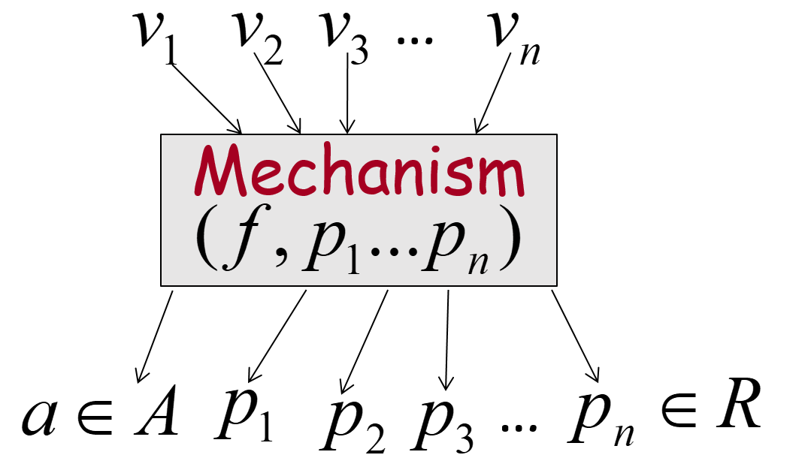
Mechanisms with money-cont.
A mechanism with money consists of:
Social choice function: $f:V_{1}×V_{2}⋯V_{n}→A$
Payments: $p_{i}:V_{1}×V_{2}⋯V_{n}→R$ - payment for player $i$.
The utility function of player $i$: ${u_{i}=v}_{i}\left(a\right)−p_{i}$

Slide 34
Truthful Mechanism
The utility function of player $i$ maximizes when he tells the truth.
$∀i∈\left[n\right],v_{i},v_{i}^{′}∈V_{i}, and v_{−i }$
$$v_{i}\left(f\left(v_{i},v_{−i}\right)\right)−p_{i}\left(v_{i},v_{−i}\right)$$
$$≥v_{i}\left(f\left(v_{i}′,v_{−i}\right)\right)−p_{i}\left(v_{i}′,v_{−i}\right)$$
Other names: Incentive Compatible and strategyproof

Slide 35
Our goal
Social welfare: $\sum_{i}{v_{i}\left(a\right)}$
Find a mechanism that:
Truthful;
Maximizes the social welfare.

Slide 36
VCG Mechanism
Definition: VCG (Vichery Clarke Grove) mechanism: a mechanism with money s.t:
Given valuations$v_{1},v_{2},⋯v_{n}$, returns:
$$f\left(v_{1},v_{2},⋯v_{n}\right)=arg\max_{a∈A}\sum_{i}{v_{i}\left(a\right)}$$
$$p_{i}\left(v_{1},v_{2},⋯v_{n}\right)=h_{i}\left(v_{−i}\right)−\sum_{j≠i}{v_{j}(a)}$$
Theorem: VCG mechanism is truthful and maximizes the social welfare.

Slide 37
VCG is truthful
Fix $i ,$ $v_{−i}$, real valuation $v_{i}$ and false one $v_{i}′$
Define $a=f\left(v_{i},v_{−i}\right)$ and $a′=f(v_{i}′,v_{−i})$
The player’s utility when he tell the truth:
$u_{i}=v_{i}\left(a\right)−(h_{i}\left(v_{−i}\right)−\sum_{j≠i}{v_{j}(a)}$)
$=\sum_{j∈\left[n\right]}{v_{j}(a)}−h_{i}\left(v_{−i}\right)$
The player’s utility when reports false valuation:
$u_{i}′=v_{i}\left(a′\right)−(h_{i}\left(v_{−i}\right)−\sum_{j≠i}{v_{j}(a′)}$)
$=\sum_{j∈\left[n\right]}{v_{j}(a′)}−h_{i}\left(v_{−i}\right)$

Slide 38
Clarke Pivot Payments
Choose $h_{i}\left(v_{−i}\right)=\max_{b∈A}\sum_{j≠i}{v_{j}(b)}$.
$$p_{i}=\max_{b∈A}\sum_{j≠i}{v_{j}(b)}−\sum_{j≠i}{v_{j}(a)}$$
Second price auction
Matching auction

Slide 39
Issues with VCG Mechanisms
Other objective functions, e.g. fairness
Computational tractability
Payment constraint, e.g. budget

Slide 40
Bayes Revenue Maximization
Selling items to a number of agents.
The valuations of the agents are drawn from a known distribution.
The seller would like to maximize the expected total payment.
We focus on the simplest case first: single item.

Slide 41
Simple pricing scheme
Set a price $p$ for the item.
An agent will buy the item and pay $p$ if he values the item at least $p$.
He will leave and pay 0 if he values the item less than $p$.
Which price $p$maximize the expected revenue?

Slide 42
Simple pricing scheme
$$Rev=p (1−\prod_{i=1}^{n}{\operatorname{Pr}{[v_{i}<p])}}$$
For example, two i.i.d. buyers with values uniform in [0,1]
$$Rev=p(1−p^{2})$$
It achieves maximum $\frac{2\sqrt{3}}{9}≈0.3849$ when $p=\frac{\sqrt{3}}{3}$.

Slide 43
Sequential Posted-Pricing
Order the buyer in some way.
The seller sequentially posts price $p_{i}$ to the $i$-th coming buyer.
The item is sold to the $i$-th buyer who ﬁrst values it $v_{i}≥p_{i}$.

Slide 44
Sequential Posted-Pricing
$$Rev=\sum_{i=1}^{n}{p_{i}\operatorname{Pr}\left[v_{i}≥p_{i}\right]\prod_{j=1}^{i−1}{\operatorname{Pr}{[v_{j}<p_{j}]}}}$$
To get more revenue, we choose
$$p_{1}≥p_{2}≥⋯≥p_{n}$$

Slide 45
Back to the example
Two i.i.d. buyers with values uniform in [0,1]
$rev=p_{1}\left(1−p_{1}\right)+p_{2}\left(1−p_{2}\right)p_{1}$
When $p_{1}=\frac{5}{8}$ and $p_{2}=\frac{1}{2}$, it reaches its maximum $\frac{25}{64}≈0.3906$
Recall that the maximum revenue is $0.3849$ for uniform pricing.

Slide 46
Second Price Auction
Two i.i.d. buyers with values uniform in [0,1]
$\operatorname{Pr}\left[second price<v\right]=1−{\left(1−v\right)}^{2}$
Density function= $2(1−v)$
$rev=\int_{0}^{1}{2v(1−v)d}=\frac{1}{3}$

Slide 47
Optimal auction design
Pricing can be viewed as a special (simple) auction mechanism.
We focus on truthful auctions.
Which auctions mechanism maximize the expected revenue?

Slide 48
Revenue optimal auction
(Myerson ’81)
Goal: find a monotone $\vec{x}$ that maximizes $E\left(\sum_{i}{p_{i}}\right)$
Myerson’s lemma:
$$E\left(\sum_{i}{p_{i}}\right)=E\left(\sum_{i}{φ_{i}(v_{i})x_{i}(v_{i})}\right)$$
virtual valuation: $φ_{i}\left(v\right)=v−\frac{1−F_{i}\left(v\right)}{f_{i}\left(v\right)}$
$F$ is said to be regular if $φ_{i}$ is monotone
If $F$ is regular, the optimal auction is to allocate the item to the bidder with the highest positive virtual value.

Slide 49
Second price auction with reserve price
Assume i.i.d. valuations, regular $F$
Bidder $i$ wins ⇒ $φ_{1}\left(v_{i}\right)≥\max_{j}\left\{φ_{1}\left(v_{j}\right),0\right\}$
⇒$v_{i}≥\max_{j}\left\{v_{j},{φ_{1}}^{−1}\left(0\right)\right\}$
Second price auction with reserve price ${φ_{1}}^{−1}(0)$ maximizes expected revenue

Slide 50
Examples of virtual valuations
Ex. 1 $Fi(v)$ uniform on $[0, h_{i}]$
Ex. 2 $Fi(v)$ = $1 − e^{−_{i}v}$
$$φ_{i}\left(v_{i}\right)=v_{i}−\frac{1}{λ_{i}}$$
$$φ_{i}\left(v_{i}\right)=2v_{i}−h_{i}$$
$$h_{i}$$
$$h_{i}$$
$$v_{i}$$
$$v_{i}$$
$$−\frac{1}{λ_{i}}$$
$${−h}_{i}$$

Slide 51
Example reserve prices
Ex. 1 $Fi(v)$ uniform on $[0, h_{i}]$
Ex. 2 $Fi(v)$ = $1 − e^{−_{i}v}$
$$φ_{i}\left(v_{i}\right)=v_{i}−\frac{1}{λ_{i}}$$
$$φ_{i}\left(v_{i}\right)=2v_{i}−h_{i}$$
$$h_{i}$$
$$h_{1}$$
$$v_{i}$$
$$v_{i}$$
$$−\frac{1}{λ_{i}}$$
$$r=\frac{h_{1}}{2}$$
$$r=\frac{1}{λ_{i}}$$
$$−h_{i}$$

Slide 52
Back to the example
Two i.i.d. buyers with values uniform in [0,1]
Optimal: Second price with reserve $0.5$.
Optimal revenue is $\frac{5}{12}≈0.4167$
Uniform pricing: $0.3849$
Sequential Posted-Pricing: $0.3906$
Second price auction: $0.3333$
How large can the gaps be?

Slide 53
Simple v.s. Optimal
Simple is better
Discrimination and fairness
Less communication and more privacy
…

Slide 54
Four mechanisms
Myerson Auction
Sequential Posted-Pricing
Second-Price Auction with Anonymous Reserve
Anonymous Pricing
[Jin, L., Tang, Xiao SODA 2019]

Slide 55
Myerson Auction
Sequential Posted-Pricing
Second-Price Auction with Anonymous Reserve
Anonymous Pricing
The relative power of auction vs. pricing. schemes, when no discrimination is allowed.
We get a tight ratio of $\frac{π^{2}}{6}≈1.64$.

Slide 56
Proof Sketch
The CDF for highest bid from ${\left\{F_{i}\right\}}_{i=1}^{n}$ is
The CDF for the second highest bid is

Slide 57
Proof Sketch (cont.)
The revenue from Anonymous Reserve is
The revenue gap is characterized by the following program.

Slide 58
Proof Sketch (cont.)
Let and
Then we have $D_{1}\left(p\right)≥Φ_{1}(p)$ and $D_{2}\left(p\right)≥Φ_{2}(p)$

Slide 59
Proof Sketch (cont.)

Slide 60
Myerson Auction
Sequential Posted-Pricing
Second-Price Auction with Anonymous Reserve
Anonymous Pricing
The power of discrimination in pricing schemes.
We get a tight ratio of 2.62.

Slide 61
Myerson Auction
Sequential Posted-Pricing
Second-Price Auction with Anonymous Reserve
Anonymous Pricing
The optimal auction and the simplest auction.
We get a tight ratio of 2.62.

Slide 62
Myerson Auction
Sequential Posted-Pricing
Second-Price Auction with Anonymous Reserve
Anonymous Pricing
Power of discrimination in auctions.
$[2,4]−>[2,e]$, and conjectured that 2 is tight.
We improve the lower bound to $2.15$.

Slide 63
Multi-item setting [example 1]
Two items with i.i.d. distribution: take value from {1,2} with equal probability 0.5.
Singe additive buyer
If selling separately, total expected revenue is 2
Bound the two items and set price 3.
Selling probability is 0.75 and expected revenue is 3*0.75=2.25>2.

Slide 64
Multi-item setting [example 2]
Two items with i.i.d. distribution: take value from {0,1} with equal probability 0.5.
Singe additive buyer
If selling separately, total expected revenue is 1.
If bounding the two items, the optimal price is 1 and selling probability is 0.75.
Expected revenue is 1*0.75=0.75<1.

Slide 65
Multi-item setting [example 3]
Two items with i.i.d. distribution: take value from {0,1,2} with equal probability 1/3.
Singe additive buyer
If selling separately, total expected revenue is 4/3.
If bounding the two items, the optimal price is 2 and selling probability is 2/3.
Expected revenue is 2*2/3=4/3.

Slide 66
Multi-item setting [example 3]
Two items with i.i.d. distribution: take value from {0,1,2} with equal probability 1/3.
Set price of 2 for each item and a “discount price” of 3 for the bundle. [第二件半价].
With probability 2/9, sell one item at price 2. The revenue is 4/9.
With probability 3/9, set the bundle at price 3. The revenue is 1.
Total excepted revenue is 4/9+1=13/9>4/3.

Slide 67
Multi-item setting [example 4]
Two items with i.i.d. distribution: take value from {1,2,4} with probabilities 1/6, 1/2, 1/3.
The optimal mechanism is to offer the following menu:
A lottery with probability ½ for first item with price 1.
A lottery with probability ½ for second item with price 1.
The bundle with price 4.
Buy nothing with price 0.
The optimal revenue is
$$\frac{1}{36}×0+2×\frac{1}{2}×\frac{1}{6}×1+\left(1−\frac{1}{36}−2×\frac{1}{2}×\frac{1}{6}\right)×4=3\frac{7}{18}$$

Slide 68
Multi-item setting
No good characterization for optimal mechanism
Some computational results
Simple vs optimal
Some process and more open questions

Slide 69
Take-home messages
Mechanisms and algorithms
Bayes Revenue Maximization
Simple and robust
Many open questions

