Slide 1
Approximate Counting via Correlation Decay
Pinyan Lu (陆品燕), ITCS@SUFE
Institute for Theoretical Computer Science
Shanghai University of Finance and Economics

Slide 2
Outline
Counting and probability distribution
Correlation decay approach
Examples

Slide 3
Counting Problems
SAT: Is there a satisfying assignment for a given a CNF formula?
Counting SAT: How many?
Counting Colorings of a graph
Counting Independent sets of a graph
Counting perfect matchings of a bipartite graph (Permanent)
……

Slide 4
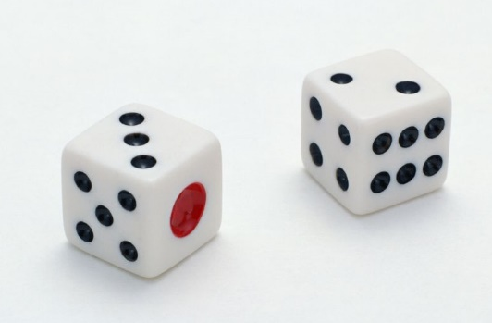
Counting Problems
Probability

Slide 5
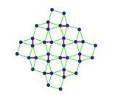
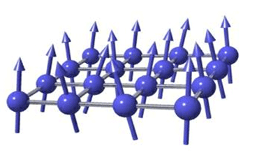
Counting Problems
Probability
Partition function on statistical physics

Slide 6
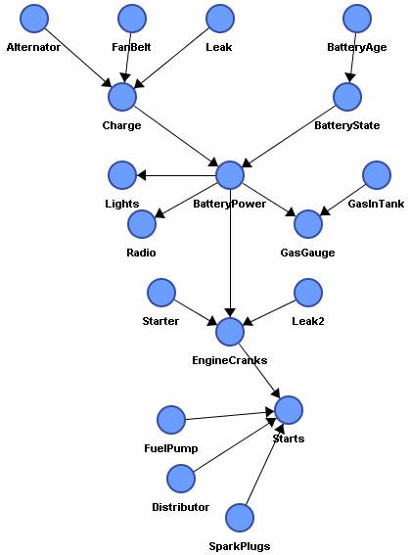
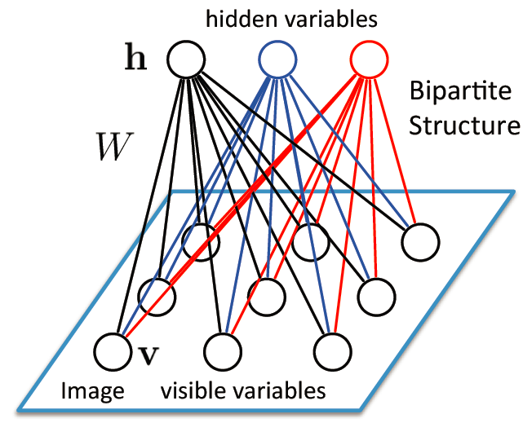
Counting Problems
Probability
Partition function on statistical physics
Inference on Graphical Models

Slide 7
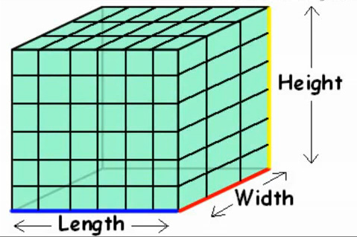
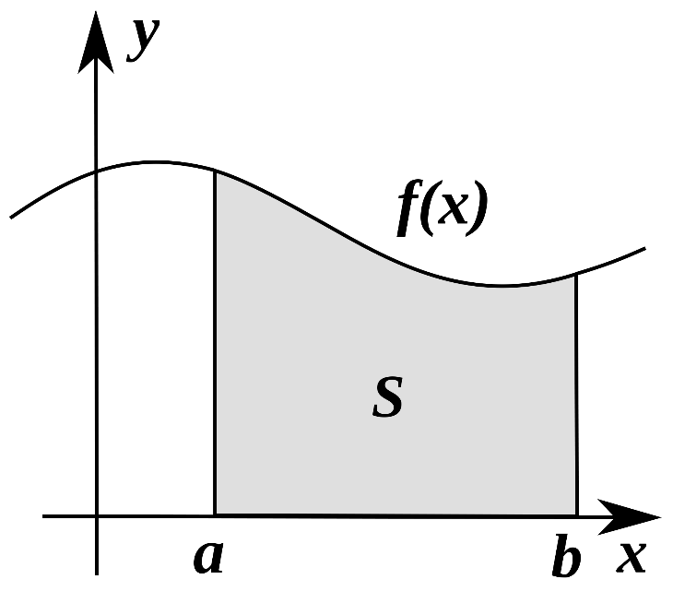
Counting Problems
Probability
Partition function on statistical physics
Inference on Graphical Models
Volume estimation and numerical integration

Slide 8
Counting Problems
Probability
Partition function on statistical physics
Inference on Graphical Models
Volume estimation and numerical integration
Query on probabilistic database
Optimization on stochastic model
……

Slide 9
Approximate Counting
Let $ε>0$ be an approximation parameter and $Z$ be the correct counting number of the instance, the algorithm returns a number $Z^{′}$ such that $\left(1−ε\right)Z≤Z^{′}≤(1+ε)Z$, in time ploy(𝑛,1/𝜖).
Fully polynomial-time approximation scheme (FPTAS).
Fully polynomial-time randomized approximation scheme (FPRAS) is its randomized version.

Slide 10
Counting vs Distribution
IS(G): the set of independent sets of graph G
X is chosen from IS(G) uniformly at random
$P_{G}\left(v\right)$: the probability that $v$ is not in X
$\operatorname{Pr}\left(X=∅\right)=\frac{1}{\left|IS\left(G\right)\right|}$
$\operatorname{Pr}\left(X=∅\right)=\operatorname{Pr}{(v_{1}v_{2}…v_{n}∉X)}$
$={P_{G}}_{1}\left(v_{1}\right){P_{G}}_{2}\left(v_{2}\right)…{P_{G}}_{n}\left(v_{n}\right)$, where $G_{1}=G, G_{i+1}=G_{i}−v_{i}$

Slide 11
Counting vs Distribution
$\frac{1}{\left|IS\left(G\right)\right|}={P_{G}}_{1}\left(v_{1}\right){P_{G}}_{2}\left(v_{2}\right)…{P_{G}}_{n}\left(v_{n}\right)$
If we can compute (estimate) $P_{G}(v)$, we can (approximately) compute |IS(G)|.
FPRAS: Estimate $P_{G}\left(v\right)$ by sampling
FPTAS: Approximately compute $P_{G}\left(v\right)$ directly and deterministically

Slide 12
Outline
Counting and probability distribution
Correlation decay approach
Examples

Slide 13
Computation Tree
Relate the probability $P_{G}\left(v\right)$ to these of its neighbors in smaller instances.
$P_{G}\left(v\right)=f(P_{G_{1}}\left(v_{1}\right),P_{G_{2}}\left(v_{2}\right), …,P_{G_{d}}\left(v_{d}\right))$
$$P_{G}\left(v\right)$$
$$P_{G_{1}}\left(v_{1}\right)$$
$$P_{G_{2}}\left(v_{2}\right)$$
$$P_{G_{d}}\left(v_{d}\right)$$

Slide 14
An example of independent sets
$P_{G}\left(v\right)=\frac{Z\left(G−v\right)}{Z\left(G\right)}=\frac{Z\left(G−v\right)}{Z\left(G−v\right)+Z(G−v−N(v))}$
$=\frac{1}{1+Z(G−v−N(v))/Z\left(G−v\right)}$
$\frac{Z\left(G−v−N(v)\right)}{Z\left(G−v\right)}=P_{G−v}(v_{1}v_{2}⋯v_{d}$)
$=P_{G_{1}}\left(v_{1}\right)P_{G_{2}}(v_{2} )…P_{G_{d}}\left(v_{d}\right)$
where $G_{1}=G−v, G_{i+1}=G_{i}−v_{i}$
$P_{G}\left(v\right)=\frac{1}{{1+P}_{G_{1}}\left(v_{1}\right)P_{G_{2}}(v_{2} )…P_{G_{d}}\left(v_{d}\right)}$

Slide 15
Computation Tree
Relate the probability $P_{G}\left(v\right)$ to these of its neighbors in smaller instances.
$P_{G}\left(v\right)=f(P_{G_{1}}\left(v_{1}\right),P_{G_{2}}\left(v_{2}\right), …,P_{G_{d}}\left(v_{d}\right))$
$$P_{G}\left(v\right)$$
$$P_{G_{1}}\left(v_{1}\right)$$
$$P_{G_{2}}\left(v_{2}\right)$$
$$P_{G_{d}}\left(v_{d}\right)$$

Slide 16
Correlation Decay
Truncate the computation tree at depth L, we can compute an estimation $P_{G}^{L}\left(v\right)$.
The system is called of exponential correlation decay if
$\left|P_{G}^{L}\left(v\right)−P_{G}\left(v\right)\right|≤exp(−L)$.
We can estimate $P_{G}\left(v\right)$ by set $L=O(\log{n+\log{\frac{1}{ε}})}$

Slide 17
Computational Efficient Correlation Decay
M-based depth:
$L_{M}\left(root\right)=0$;
$L_{M}\left(u\right)=L_{M}\left(v\right)+⌈\log_{M}{(d+1)}⌉$, if $u$ is one of the $d$children of $v$.
Exponential correlation decay with respect to M-based depth.
Computational efficient correlation decay supports FPTAS for general graph.

Slide 18
Proof Sketch for Correlation Decay
$p=f(p_{1}, p_{2}, …,p_{d})$
Estimate the error for one recursive step:
$$ε=\frac{∂f}{∂p_{1}}ε_{1}+\frac{∂f}{∂p_{2}}ε_{2}+…+\frac{∂f}{∂p_{d}}ε_{d}$$
$$|ε|≤\left(\left|\frac{∂f}{∂p_{1}}\right|+\left|\frac{∂f}{∂p_{2}}\right|+…+\left|\frac{∂f}{∂p_{d}}\right|\right)max⁡({|ε}_{i}|)$$
$\left(\left|\frac{∂f}{∂p_{1}}\right|+\left|\frac{∂f}{∂p_{2}}\right|+…+\left|\frac{∂f}{∂p_{d}}\right|\right)<1$ ?

Slide 19
Potential Function
This may not be correct stepwise. We use a potential function to amortize it.
Let $φ:R^{+}→R^{+}$ be a bijective function. $q=φ\left(p\right),q_{i}=φ\left(p_{i}\right).$
$q=φ\left(f\left({φ^{−1}(q}_{1}),{φ^{−1}(q}_{2}), …,{φ^{−1}(q}_{d})\right)\right)$.
Then we show that the error for $q$is stepwise decreased by a constant factor.
The main difficulty is to find the potential function $φ$.

Slide 20
Outline
Counting and probability distribution
Correlation decay approach
Examples

Slide 21
Spin Systems
System $G=(V,E)$ and spin states $[q]$
Configuration $σ:V→\left[q\right]$
Edge function $A:\left[q\right]×\left[q\right]→R^{+}$
Vertex function b: [q]-> $R^{+}$
Weight of a configuration
$$w\left(σ\right)=(\prod_{\left(u,v\right)∈E}{A(σ\left(u\right),σ\left(v\right))}(\prod_{v∈V}{b(σ\left(v\right))})$$
Partition function: $Z_{A\left(G\right)}=\sum_{σ}{w(σ)}$

Slide 22
Spin Systems
A model in Statistical Physics and Applied Probability
A framework of many combinatorial counting problems
Have applications in AI, coding theory and so on.

Slide 23
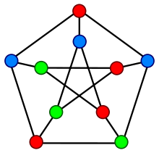
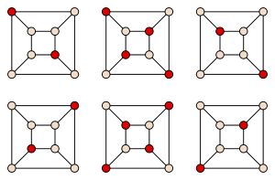
Constraint Satisfaction Problems
Graph coloring
$$A= \left[\begin{matrix}0 & 1 & 1 \\ 1 & 0 & 1 \\ 1 & 1 & 0\end{matrix}\right]$$
Independent set
$$A=\left[\begin{matrix}1 & 1 \\ 1 & 0\end{matrix}\right]$$
Partition function:
Counting the number of solutions

Slide 24
Two-State Spin System
After normalization: $A=\left[\begin{matrix}β & 1 \\ 1 & γ\end{matrix}\right]$ , $b=\left[\begin{aligned}λ \\ 1\end{aligned}\right]$
Ferromagnetic system: $βγ>1$
Anti-ferromagnetic system: $βγ<1$
Hardcore model : $A=\left[\begin{matrix}1 & 1 \\ 1 & 0\end{matrix}\right]$
Ising model: $A=\left[\begin{matrix}β & 1 \\ 1 & β\end{matrix}\right]$

Slide 25
Uniqueness Condition
$f(x)={λ\left(\frac{βx+1}{x+γ}\right)}^{d}$.
Let $\hat{x}=f(\hat{x})$ be the fixed point of $f$.
The system is called $d$-uniqueness if
$$\left|f^{′}\left(\hat{x}\right)\right|<1$$
This can be numerically tested, but there is no closed form in general.

Slide 26
Hardcore Model [Weitz 2006]
FPTAS for graphs with maximum degree at most $Δ$ if the uniqueness condition holds on infinite $Δ$-regular tree.
Self Avoiding walk(SAW) tree: transform a general graph to a tree and the keep the marginal distribution for the root.
Monotonicity: any tree with degree at most $Δ$ decays at least as fast as the complete $Δ$-regular tree.

Slide 27
Ising Model [Sinclair, Srivastava, and Thurley 2011]
FPTAS for graphs with maximum degree at most $Δ$ if the uniqueness condition holds on infinite $Δ$-regular tree.
Have the same monotonicity property as hardcore model.
Monotonicity does not hold for general two-state spin systems.

Slide 28
General cases[Li, L., Yin 2012,13]
Potential Function
FPTAS for graphs with maximum degree $Δ$if the system exhibits uniqueness on all the infinite regular trees up to degree $Δ$.
In particular, if the system exhibits uniqueness on infinite regular trees of all degrees, then FPTAS for general graphs.
There is a matching hardness result [Sly, Sun 2012]: It is NP-hard if the system does not satisfy the uniqueness condition.
Computational Efficient Correlation Decay

Slide 29
Correlation decay for #IS
$P_{G}\left(v\right)=\frac{1}{{1+P}_{G_{1}}\left(v_{1}\right)P_{G_{2}}(v_{2} )…P_{G_{d}}\left(v_{d}\right)}$
Define: $R_{G}\left(v\right)=\frac{1−P_{G}\left(v\right)}{P_{G}\left(v\right)}$
$R_{G}\left(v\right)=\prod_{i=1}^{d}{\frac{1}{1+R_{G_{i}}\left(v_{i}\right)}}$
Define: $f\left(x\right)=\prod_{i=1}^{d}{\frac{1}{1+x_{i}}}$

Slide 30
Correlation decay for #IS (cont.)
$f\left(x\right)=\prod_{i=1}^{d}{\frac{1}{1+x_{i}}}$
Find $Φ(⋅)$such that $\sum_{i}^{d}{\left|\frac{∂f}{∂x_{i}}\right| \frac{Φ(f)}{Φ\left(x_{i}\right)}}<1$
Choose $Φ\left(x\right)=\frac{1}{\sqrt{x\left(1+x\right)}}$
$\sum_{i}^{d}{\left|\frac{∂f}{∂x_{i}}\right| \frac{Φ(f)}{Φ\left(x_{i}\right)}}=\sqrt{\frac{f}{1+f}}\sum_{i}{\sqrt{\frac{x_{i}}{1+x_{i}}}}$
Symmetrize $x_{i}$ by Jensen’s inquality and get a function with a single variable
It works!

Slide 31
Ferromagnetic two-spin systems
FPRAS for Ferro$(β,β, λ)$ with any $λ$. [Jerrum and Sinclair 1993]
FPRAS for Ferro$(β,γ, 1)$ with any $βλ>1$. [Goldberg, Jerrum and Paterson 2003]
FPTAS for Ferro$(β,γ, 1)$ for some ranges of $(β,γ)$. [L., Wang and Zhang 2013]
It is #BIS-hard for ferromagnetic Ising with inconsistent local fields. [Goldberg, Jerrum 2007]
For any Ferro$(β,γ,λ)$ with $β≠γ$, there exists a threshold for external fields beyond which the problem is #BIS-hard. [Liu, L., Zhang 2014]

Slide 32
Ferromagnetic two-spin systems
[Guo, L. 2016]: There is a critical $Δ_{c}$ and $λ_{c}$ (as a function of $β$ and $γ$)
FPTAS if maximum degree is bounded by $Δ_{c}$
FPTAS if $λ<λ_{c}$ and $β≤1$ (no degree bounds)
Conjecture: FPTAS as long as $λ<λ_{c}$
Weak correlation decay as long as $λ<λ_{c}$
MCMC works if $λ<λ_{c}$ and minimum degree is at least $Δ_{c}$

Slide 33
More Examples
Two state spin systems
Multi-spin systems
Multi-part systems

Slide 34
Coloring
There is always a solution if $q≥Δ+1.$
FPRAS if $q>\frac{11}{6}Δ$ [Vigoda 99]
FPTAS if $q>2.8432Δ+C$ [Gamarnik, Katz 07]
FPTAS if $q>2.581Δ+1$ [L., Yin 2013]
FPTAS for $q=4,Δ=3$ [L., Yang, Zhang, Zhu 2017]
Potential Function
$q$: number of colors
$Δ:$maximum degree of the graph

Slide 35
Multi-spin System
Also called (Pairwise) Markov Random Field
$c_{A}=\max{A(x,y)/A(z,w})$
We obtain an FPTAS when $3Δ\left(c_{A}−1\right)<1$
Potts model: inverse temperature $|β|=O(\frac{1}{Δ})$
Previously
$\left(c_{A}^{Δ}−c_{A}^{−Δ}\right)Δ q^{Δ}<1$
$\left|β\right|=O(\frac{1}{Δq^{Δ}})$
More efficient
recursive function

Slide 36
Counting Edge Covers
A set of edges such that every vertex has at least one adjacent edge in it

Slide 37
Counting Edge Covers
A set of edges such that every vertex has at least one adjacent edge in it
FPRAS for 3-regular graphs based on Markov Chain Monte Carlo[Bezakova, Rummler 2009].
FPTAS for general graphs. [Lin, Liu, L. 2014]
Computational Efficient Correlation Decay

Slide 38
Counting weighted Edge Covers
FPTAS for general edge weighted graphs, given that the weights are bounded away from 0. [Liu, L., Zhang 2014]
For exponential small weights, it becomes counting perfect matchings for general graphs.
Similar situation as counting weighted matchings.
Potential Function

Slide 39
Counting Monotone CNF [Liu, L. 2015]
A CNF formula is monotone if each variable appears positively.
We give a FPTAS to count the number of solutions for a monotone CNF when each variable appears at most five times.
It is NP-hard to approximately count if we allow a variable to appear six times.
Two-layer
recursive function

Slide 40
#BIS
Counting independent sets for bipartite graphs.
Conjectured to be of intermediate complexity.
Plays a similar role as the Unique Game for optimization problems.
A large number of other problems are proved to have the same complexity as #BIS (#BIS-equivalent) or at least as hard as #BIS (#BIS-hard)

Slide 41
#BIS
Local MCMCs mixes slowly even on bipartite graphs.
For NP-hardness of #IS, reduction from Max-CUT, which is always easy for bipartite graphs.
#BIS with a maximum degree of 6 is already as hard as general #BIS (#BIS-hard). [CGGGJSV14]
No algorithmic evidence to distinguish #BIS from #IS.

Slide 42
Some approximation trichotomies
Boolean CSP [Dyer, Goldberg, Jerrum 10]
Degree bounded Boolean CSP [Dyer, Goldberg, Jalsenius, Richerby 12]
Conservative weighted Boolean CSPs[Bulatov, Dyer, Goldberg, Jerrum, McQuillan 13]
#SAT
#BIS
FPTAS/FPRAS

Slide 43
#BIS
FPTAS for #BIS when the maximum degree for one side is no larger than 5. [Liu, L. 2015]
No restriction for the degrees on the other side.
Identical to Weitz's algorithm for general #IS.
Combine two recursion steps into one, and work with this two-layer recursion instead.

Slide 44
Two-layer recursion
$R_{G}\left(v\right)=\prod_{i=1}^{d}{\frac{1}{1+R_{G_{i}}\left(v_{i}\right)}}$
$R_{G_{i}}\left(v_{i}\right)=\prod_{j=1}^{d_{i}}{\frac{1}{1+R_{G_{ij}}\left(v_{ij}\right)}}$
$R_{G}\left(v\right)=\prod_{i=1}^{d}{{\left(1+\prod_{j=1}^{d_{i}}{\frac{1}{1+R_{G_{ij}}\left(v_{ij}\right)}}\right)}^{−1}}$
Define $f\left(x\right)$=$\prod_{i=1}^{d}{{\left(1+\prod_{j=1}^{d_{i}}{\frac{1}{1+x_{ij}}}\right)}^{−1}}$

Slide 45
Choice of the Potential Function
Recall: $f\left(x\right)$=$\prod_{i=1}^{d}{{\left(1+\prod_{j=1}^{d_{i}}{\frac{1}{1+x_{ij}}}\right)}^{−1}}$
$$\sum_{i,j}{\left|\frac{∂f}{∂x_{ij}}\right| \frac{Φ(f)}{Φ\left(x_{ij}\right)}}=Φ\left(f\right)f\sum_{i}{\frac{\prod_{j=1}^{d_{i}}{\frac{1}{1+x_{ij}}}}{1+\prod_{j=1}^{d_{i}}{\frac{1}{1+x_{ij}}}}}\sum_{j}{\frac{1}{Φ\left(x_{ij}\right)\left(1+x_{ij}\right)}}$$
Choose: $Φ\left(x\right)=\frac{1}{\left(1+x\right)Log\left(1+x\right)}$
$$Log\prod_{j=1}^{d_{i}}{\left(1+x_{ij}\right)}$$

Slide 46
$Φ\left(x\right)=\frac{1}{\left(1+x\right)Log\left(1+x\right)}$
$s_{i}≜\prod_{j=1}^{d_{i}}{\frac{1}{\left(1+x_{ij}\right)}}$
$f\left(x\right)$=$\prod_{i=1}^{d}{\frac{1}{1+s_{i}}}$
$\sum_{i,j}{\left|\frac{∂f}{∂x_{ij}}\right| \frac{Φ(f)}{Φ\left(x_{ij}\right)}}=−Φ\left(f\right)f\sum_{i}{\frac{s_{i}}{1+s_{i}}Log}(s_{i})$
Symmetrize $s_{i}$ and get a function with a single variable
It works!

Slide 47
Adaptive Truncation
$R_{G}\left(v\right)=\prod_{i=1}^{d}{{\left(1+\prod_{i=1}^{d_{i}}{\frac{1}{1+R_{G_{ij}}\left(v_{ij}\right)}}\right)}^{−1}}$
$d$is bounded by 4 but there is no bound for $d_{i}$
Some $d_{i}$ may even be super constant
Computational efficient correlation decay

Slide 48
Concluding Remarks
Algorithm design part is kind of standard.
The over framework for the analysis is the same.
A number of techniques and tools have been developed to the analysis.
However, it is still very challenging to prove and many problems remains open.

Slide 49
Thank You!
Q & A

