Slide 1
Prophet Inequality
& Secretary Problem
Nick Gravin, ITCS SHUFE

Slide 2
The Plan
Introduction to Prophet Inequalities
Connections to Pricing and Mechanism Design
Solution to single-choice setting
Introduction to Secretary problem
Solution to basic setting

Slide 3
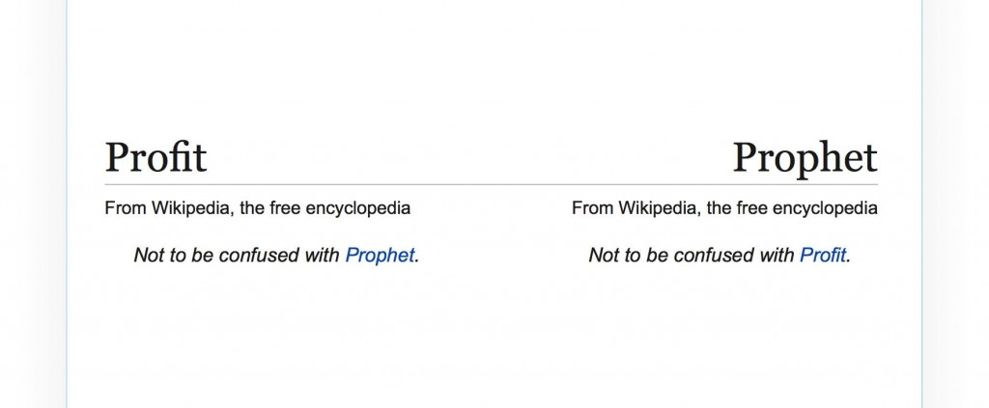

Slide 4
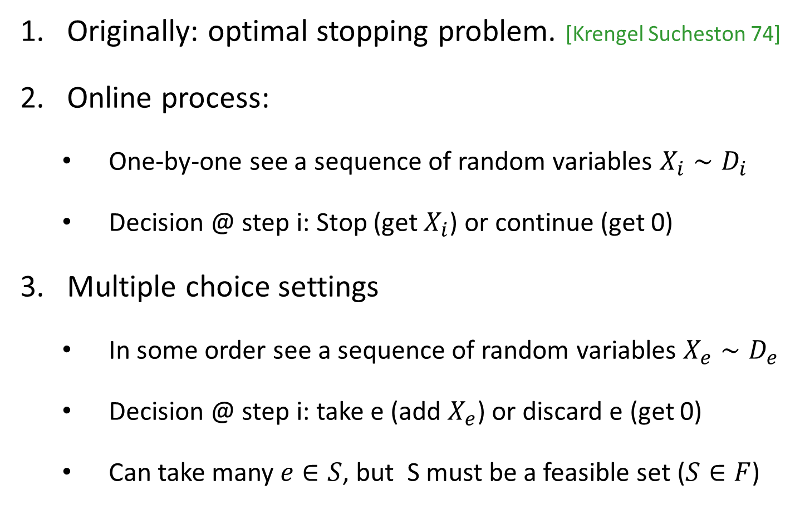
Prophet inequality
Originally: optimal stopping problem. [Krengel Sucheston 74]
Online process:
  One-by-one see a sequence of random variables $X_{i}∼D_{i}$
  Decision @ step i: Stop (get $X_{i}$) or continue (get 0)
Multiple choice settings
  In some order see a sequence of random variables $X_{e}∼D_{e}$
  Decision @ step i: take e (add $X_{e}$) or discard e (get 0)
  Can take many $e∈S$, but S must be a feasible set ($S∈F$)

Slide 5
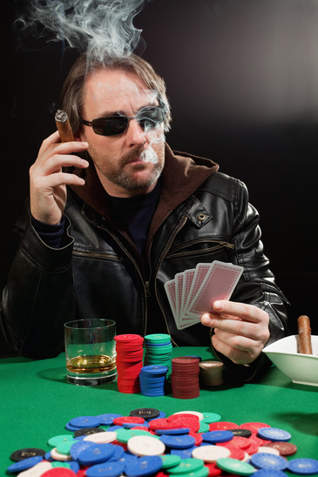
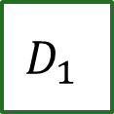




Prophet Inequality
The gambler’s problem:
$$D_{1}$$
$$D_{2}$$
$$D_{3}$$
$$D_{4}$$
$$D_{5}$$
Notes:
Describing prophet inequality as a game

Slide 6
Prophet Inequality
The gambler’s problem:
$20
$$D_{1}$$
$$D_{2}$$
$$D_{3}$$
$$D_{4}$$
$$D_{5}$$
Keep: win $20, game stops.
Discard: prize is lost, game
continues with next box.
Notes:
Boxes arrive and are opened one by one.
Gambler chooses whether to keep the prize (end game), or move on.
The distributions from which prizes are drawn are known in advance. Independent across boxes.

Slide 7
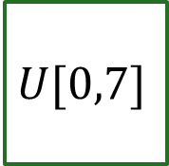
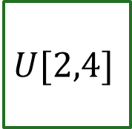

Let’s Play…
3.16
2.87
1.14
2.67
$$U[2,4]$$
$$U[2,4]$$
$$U[1,5]$$
$$U[0,7]$$

Slide 8
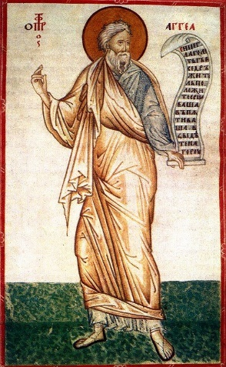
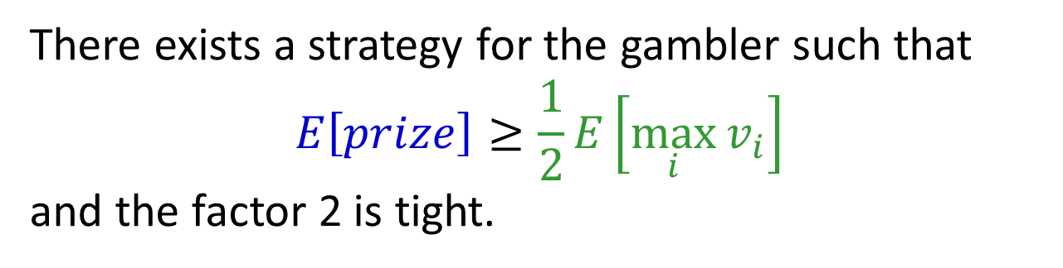
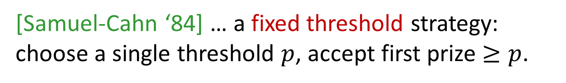
Prophet Inequality
Theorem: [Krengel, Sucheston, Garling ‘77]
There exists a strategy for the gambler such that
$$E\left[prize\right]≥\frac{1}{2}E\left[\max_{i}{v_{i}}\right]$$
and the factor 2 is tight.
[Samuel-Cahn ‘84] … a fixed threshold strategy:
choose a single threshold $p$, accept first prize $≥p$.
Notes:
Prophet Haggai

Slide 9

Online Algorithms
Expected value of the optimal offline algorithm
$$E\left[prize\right]≥\frac{1}{2}E\left[\max_{i}{v_{i}}\right]$$
Expected value of the online algorithm
Competitive ratio
Notes:
Prophet Haggai

Slide 10

Lower Bound: 2 is Tight
$\frac{1}{ε}$ w.p. $ε$
0 otherwise
1

Slide 11
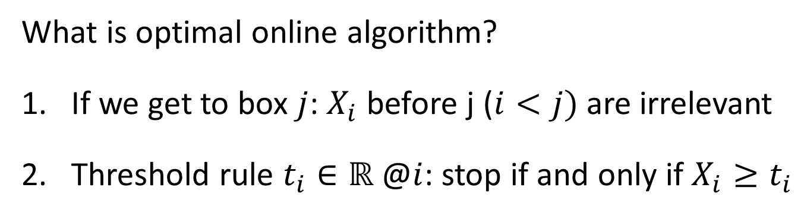
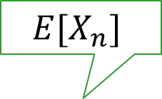
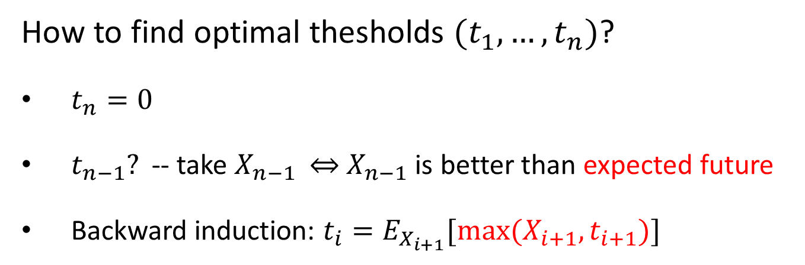
Optimal online policy
What is optimal online algorithm?
If we get to box $j$: $X_{i}$ before j ($i<j)$ are irrelevant
Threshold rule $t_{i}∈ℝ$ @$i$: stop if and only if $X_{i}≥t_{i}$
How to find optimal thesholds $(t_{1},…, t_{n})$?
$t_{n}=0$
$t_{n−1}?$ -- take $X_{n−1}$ $⇔$ $X_{n−1}$ is better than expected future
Backward induction: $t_{i}=E_{X_{i+1}}[\max{(X_{i+1},t_{i+1})}]$
$$E[X_{n}]$$

Slide 12
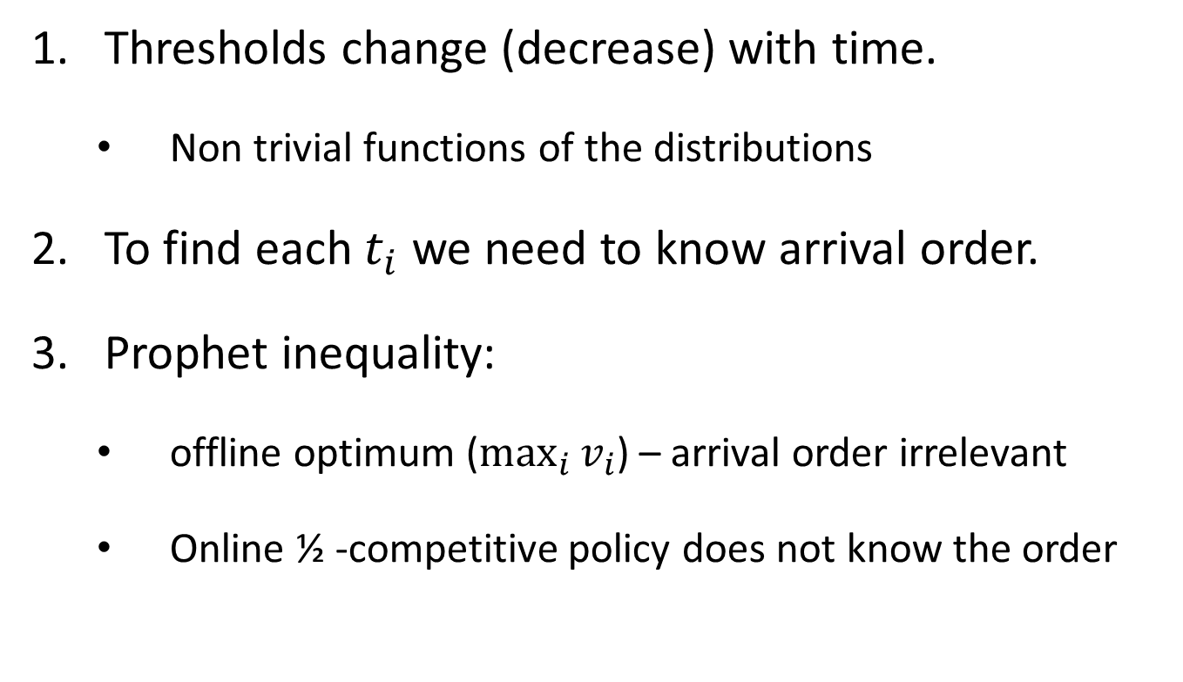
Online Optimum (cons)
Thresholds change (decrease) with time.
  Non trivial functions of the distributions
To find each $t_{i}$ we need to know arrival order.
Prophet inequality:
  offline optimum ($\max_{i}{v_{i}}$) – arrival order irrelevant
  Online ½ -competitive policy does not know the order

Slide 13


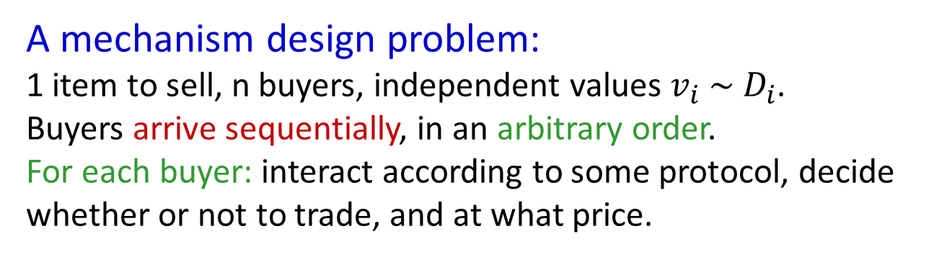



Application: Posted Pricing
A mechanism design problem:
1 item to sell, n buyers, independent values $v_{i} \sim D_{i}$.
Buyers arrive sequentially, in an arbitrary order.
For each buyer: interact according to some protocol, decide whether or not to trade, and at what price.
$$v_{1} \sim D_{1}$$
$$v_{2} \sim D_{2}$$
$$v_{3} \sim D_{3}$$
$$v_{4} \sim D_{4}$$
Corollary of Prophet Inequality:
Posting an appropriate take-it-or-leave-it price yields at least half of the expected optimal social welfare.
[Hajiaghayi Kleinberg Sandholm ’07]
Notes:
An immediate corollary

Slide 14
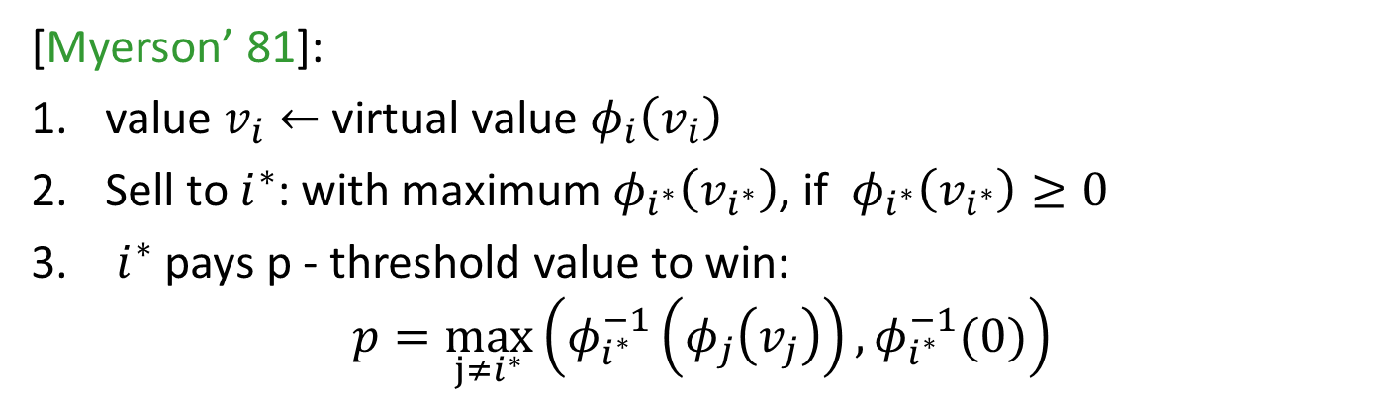
Applications (Con’t)
What about revenue?
[Chawla Hartline Malec Sivan ’10]: Can apply prophet inequality to virtual values to achieve half of optimal revenue.
Virtual value: $φ_{i}\left(v\right)=v−\frac{1−F_{i}(v)}{f_{i}(v)}$, where $F_{i}$ – cdf and $f_{i}$ is pdf.
Revenue maximizing auction: $E_{v∼F_{1}×…×F_{n}}[\max_{i}{\left(φ_{i}\left(v_{i}\right)\right)}^{+}]$
[Myerson’ 81]:
value $v_{i}←$ virtual value $φ_{i}\left(v_{i}\right)$
Sell to $i^{∗}$: with maximum $φ_{i^{∗}}\left(v_{i^{∗}}\right)$, if $φ_{i^{∗}}\left(v_{i^{∗}}\right)≥0$
$i^{∗}$ pays p - threshold value to win:
$$p=\max_{j≠i^{∗}}\left(φ_{i^{∗}}^{−1}\left(φ_{j}\left(v_{j}\right)\right),φ_{i^{∗}}^{−1}(0)\right)$$
Notes:
We won’t go into detail here about the connections between virtual value and revenue. See Matt’s tutorial for more.

Slide 15

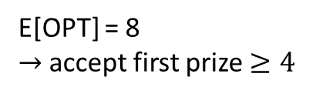
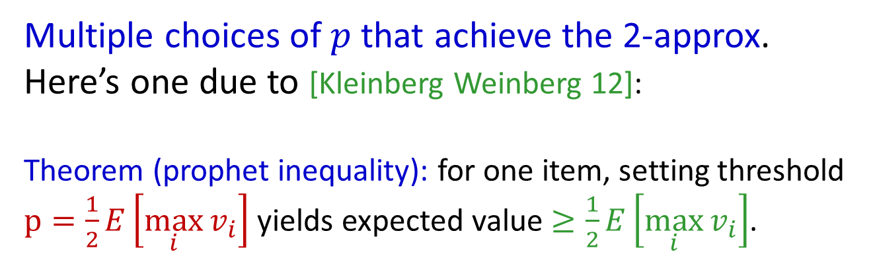
Prophet Inequality
Multiple choices of $p$ that achieve the 2-approx.
Here’s one due to [Kleinberg Weinberg 12]:
Theorem (prophet inequality): for one item, setting threshold $p=\frac{1}{2}E\left[\max_{i}{v_{i}}\right]$ yields expected value $≥\frac{1}{2}E\left[\max_{i}{v_{i}}\right]$.
Example:
10 w.p. 1/2
8 w.p. 1/4
6 w.p. 1/8
2 w.p. 1/8
OPT =
1 or 6
0 or 8
2 or 10
E[OPT] = 8
$→$accept first prize $≥4$
(each box: prizes equally likely)
Notes:
Note: not optimal! (Price 2 is better)
Also: comparison with optimal ex-post, not with the optimal price!
Also note: threshold p depends on the set of distributions, but not the arrival order!

Slide 16

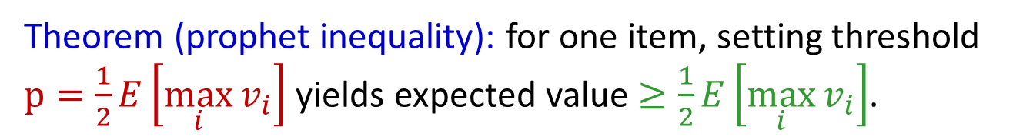
Prophet Inequality: Proof
Theorem (prophet inequality): for one item, setting threshold $p=\frac{1}{2}E\left[\max_{i}{v_{i}}\right]$ yields expected value $≥\frac{1}{2}E\left[\max_{i}{v_{i}}\right]$.
What can go wrong?
If threshold is
Too low: we might accept a small prize, preventing us from taking a larger prize in a later round.
Too high: we don’t accept any prize.

Slide 17

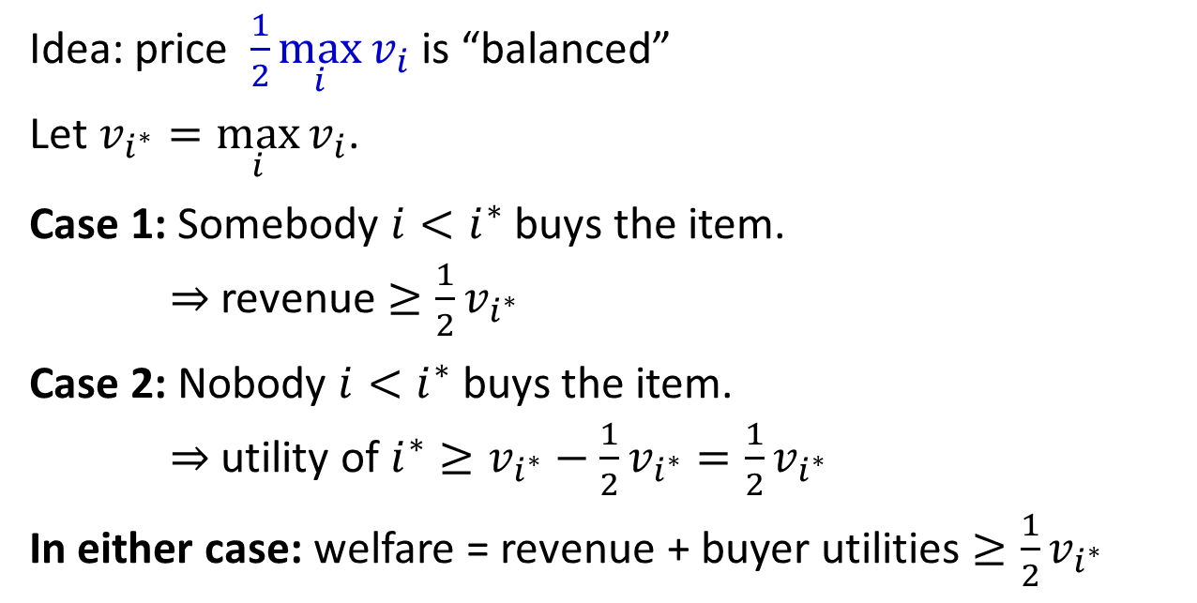



A Proof for Full Information
$$v_{1}=10$$
$$v_{2}=50$$
$$v_{3}=80$$
$$v_{4}=15$$
Idea: price $\frac{1}{2}\max_{i}{v_{i}}$ is “balanced”
Let $v_{i^{∗}}=\max_{i}{v_{i}}$.
Case 1: Somebody $i<i^{∗}$ buys the item.
$⇒$revenue $≥\frac{1}{2}v_{i^{∗}}$
Case 2: Nobody $i<i^{∗}$ buys the item.
$⇒$ utility of $i^{∗}≥v_{i^{∗}}−\frac{1}{2}v_{i^{∗}}=\frac{1}{2}v_{i^{∗}}$
In either case: welfare = revenue + buyer utilities $≥\frac{1}{2}v_{i^{∗}}$
Notes:
Again, this price of 40 is not optimal (80 is better). But we present this argument because it extends directly to the probabilistic case on the next slide

Slide 18
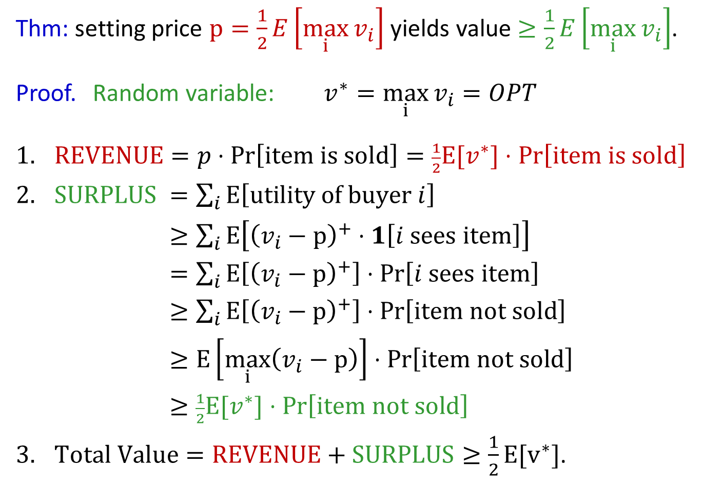
Extending to Stochastic Setting
Thm: setting price $p=\frac{1}{2}E\left[\max_{i}{v_{i}}\right]$ yields value $≥\frac{1}{2}E\left[\max_{i}{v_{i}}\right]$.
Proof. Random variable: $v^{∗}=\max_{i}{v_{i}}=OPT$
$REVENUE=p⋅\operatorname{Pr}\left[\text{item} \text{is} \text{sold}\right]=\frac{1}{2}E[v^{∗}]⋅\operatorname{Pr}\left[\text{i}\text{tem} \text{is} \text{sold}\right]$
$SURPLUS$ $=\sum_{i}{E\left[\text{utility} \text{of} \text{buyer} i\right]}$
$≥\sum_{i}{E\left[{\left(v_{i}−p\right)}^{+}⋅1\left[i \text{sees} \text{item}\right]\right]}$
$=\sum_{i}{E\left[{\left(v_{i}−p\right)}^{+}\right]⋅Pr\left[i \text{sees} \text{item}\right]}$
$≥\sum_{i}{E\left[{\left(v_{i}−p\right)}^{+}\right]⋅Pr\left[\text{item} \text{not} \text{sold}\right]}$
$≥E\left[\max_{i}\left(v_{i}−p\right)\right]⋅Pr\left[\text{item} \text{not} \text{sold}\right]$
$≥\frac{1}{2}E[v^{∗}]⋅Pr\left[\text{ite}\text{m} \text{not} \text{sold}\right]$
$Total Value=REVENUE+SURPLUS≥\frac{1}{2}E[v^{∗}]$.
Notes:
Important: linearity of expectation trick.
-> Idea: if prob of not selling is high, then prob. that max-valued player can buy is high. Since expected value of max-valued player is high, and price is low, surplus must be high!
[ equality: independence, and doesn’t depend on value. Next line: dominance. Then just take the sum. ]
Note: x^+ == max{x, 0}

Slide 19

Prophet Inequality: Proof
Thm: for one item, price $p=\frac{1}{2}E\left[OPT\right]$ yields value $≥\frac{1}{2}E\left[OPT\right]$.
Summary:
Price is high enough that expected revenue offsets the
opportunity cost of selling the item.
Price is low enough that expected buyer surplus offsets the value left on the table due to the item going unsold.

Slide 20

Multiple-Prize Prophet Inequality
Prophet inequality, but gambler can keep up to $k$ prizes
$k=1$: original prophet inequality: 2-approx
[Alaei ‘11] [Alaei Hajiaghayi Liaghat ‘12] Can be improved to
$1+O\left(\frac{1}{\sqrt{k}}\right)$ using a randomized strategy, and this is tight.
Notes:
If k is greater than 1, the problem gets EASIER. Why? Concentration (Hoeffding inequality). Get tight bound up to logs.
Can interpret as: come up with right threshold for a fractional relaxation of the problem, and the canonical rounding doesn’t do too badly.
Note: revenue is at least p * (k – blah), and buyer surplus is at least (OPT – kp).
Idea of Alaei improvement: same approach, but do the randomized rounding more carefully.

Slide 21
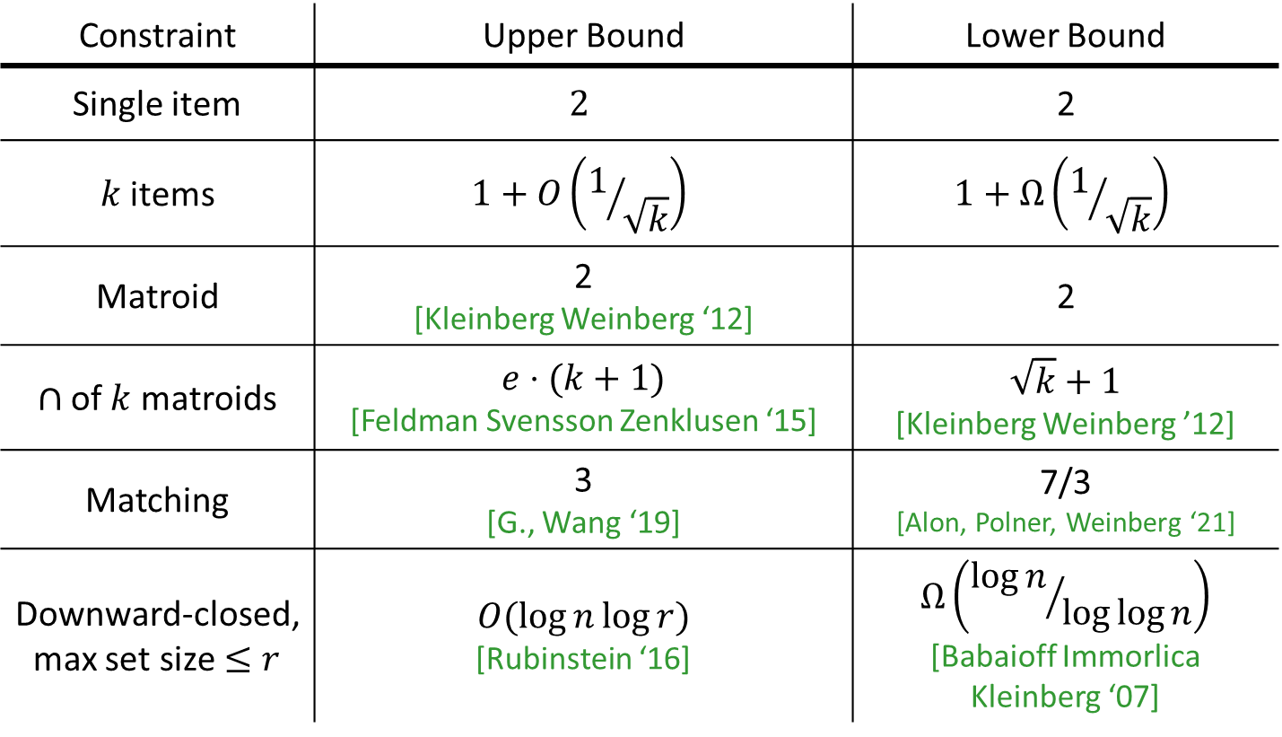
Prophet Inequality: feasibility constraints
Constraint | Upper Bound | Lower Bound
Single item | $$2$$ | 2
$k$ items | $$1+O\left(1/{\sqrt{k}}\right)$$ | $$1+Ω\left(1/{\sqrt{k}}\right)$$
Matroid | 2 [Kleinberg Weinberg ‘12] | 2
$∩$ of $k$ matroids | $e⋅(k+1)$ [Feldman Svensson Zenklusen ‘15] | $$\sqrt{k}+1$$ [Kleinberg Weinberg ’12]
Matching | 3 [G., Wang ‘19] | 7/3 [Alon, Polner, Weinberg ‘21]
Downward-closed, max set size $≤r$ | $$O(\log{n\log{r}})$$ [Rubinstein ‘16] | $$Ω\left({\log{n}}/{\log{\log{n}}}\right)$$ [Babaioff Immorlica Kleinberg ‘07]
Directly imply posted-price mechanisms for welfare, revenue
Notes:
Lots of literature on this…

Slide 22
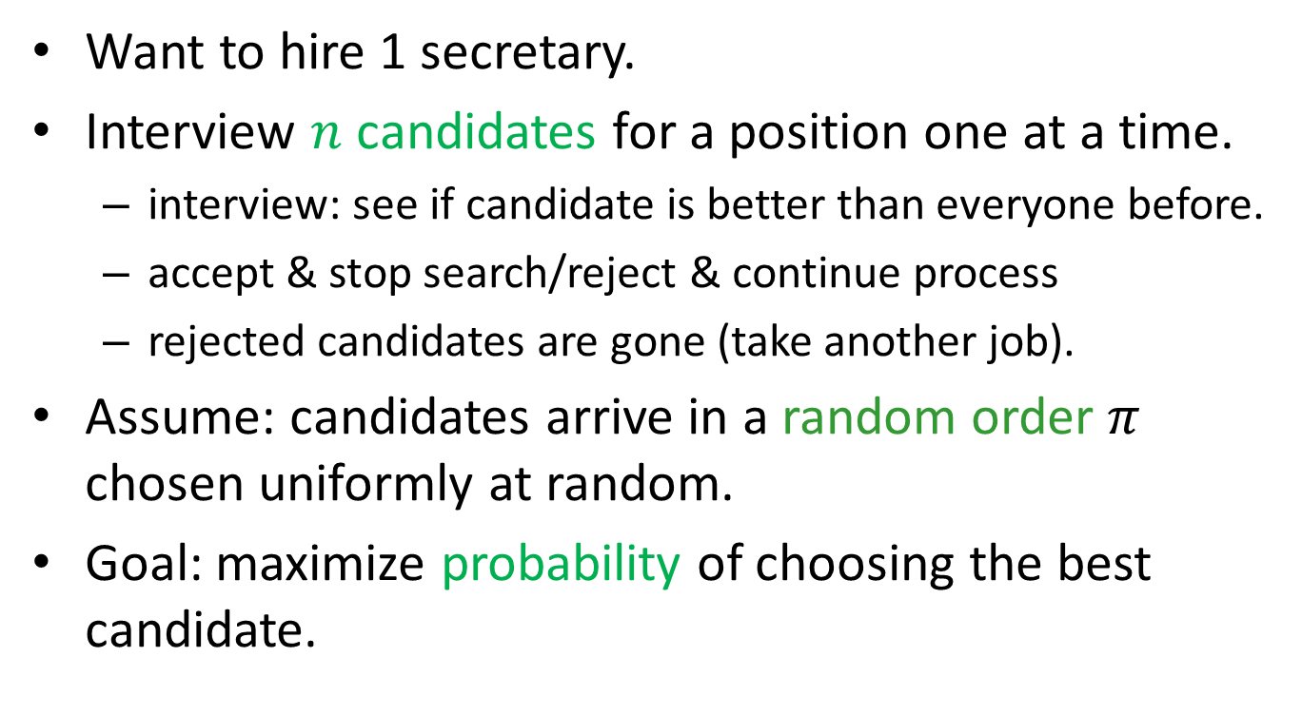
Secretary problem
Want to hire 1 secretary.
Interview $n$ candidates for a position one at a time.
  interview: see if candidate is better than everyone before.
  accept & stop search/reject & continue process
  rejected candidates are gone (take another job).
Assume: candidates arrive in a random order $π$ chosen uniformly at random.
Goal: maximize probability of choosing the best candidate.

Slide 23

Accept or reject?
1st
n = 6 candidates, 5 more to see.

Slide 24
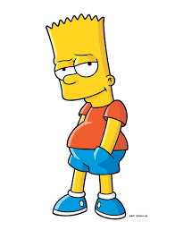
1st
2nd
<

Slide 25
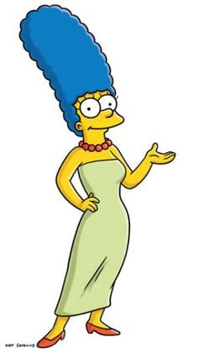
Maybe someone better will appear in the future?
1st
2nd
3rd
<
<

Slide 26

1st
2nd
3rd
4th
Marge is still the best so far
<
<
<

Slide 27

So we made a mistake.
1st
2nd
3rd
4th
5th
<
<
<
<

Slide 28

The best
1st
2nd
3rd
4th
5th
6th
<
<
<
<
<

Slide 29
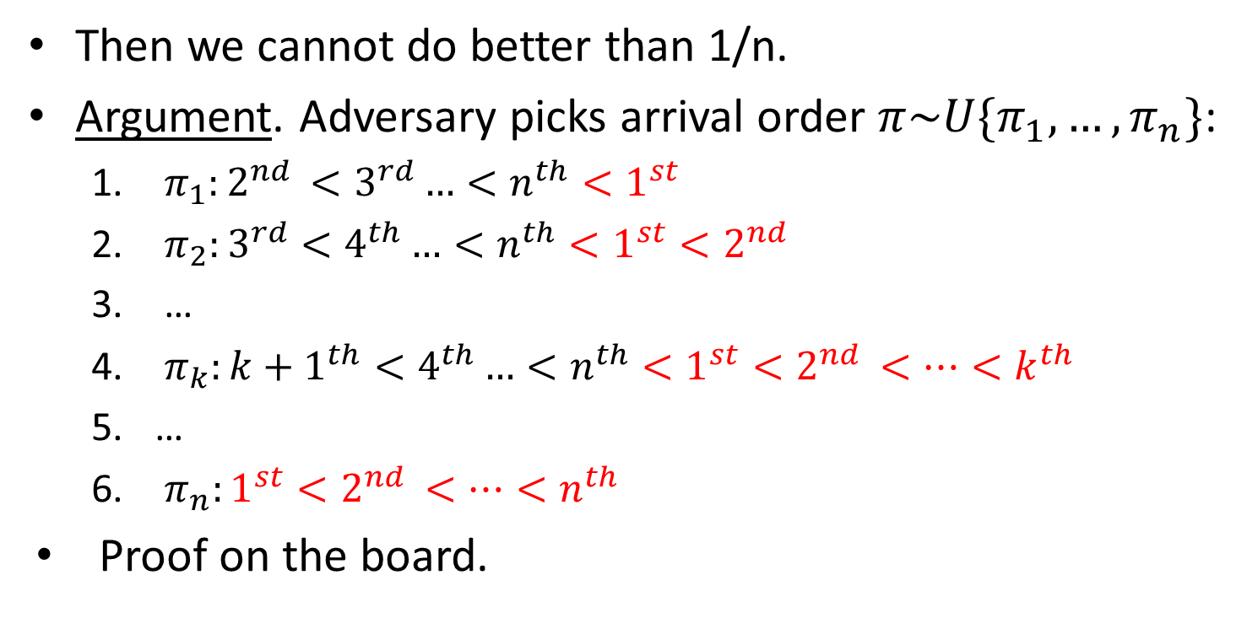
What if adversary chooses the order?
Then we cannot do better than 1/n.
Argument. Adversary picks arrival order $π\sim U\{π_{1},…,π_{n}\}$:
  $π_{1}:{2^{nd }<3^{rd}…<n^{th}<1}^{st}$
  $π_{2}:{3^{rd}<4^{th}…<n^{th}<1}^{st}<2^{nd }$
  …
  $π_{k}:{{k+1}^{th}<4^{th}…<n^{th}<1}^{st}<2^{nd }<…<k^{th }$
  …
  $π_{n}:1^{st}<2^{nd }<…<n^{th }$
Proof on the board.
Why?

Slide 30
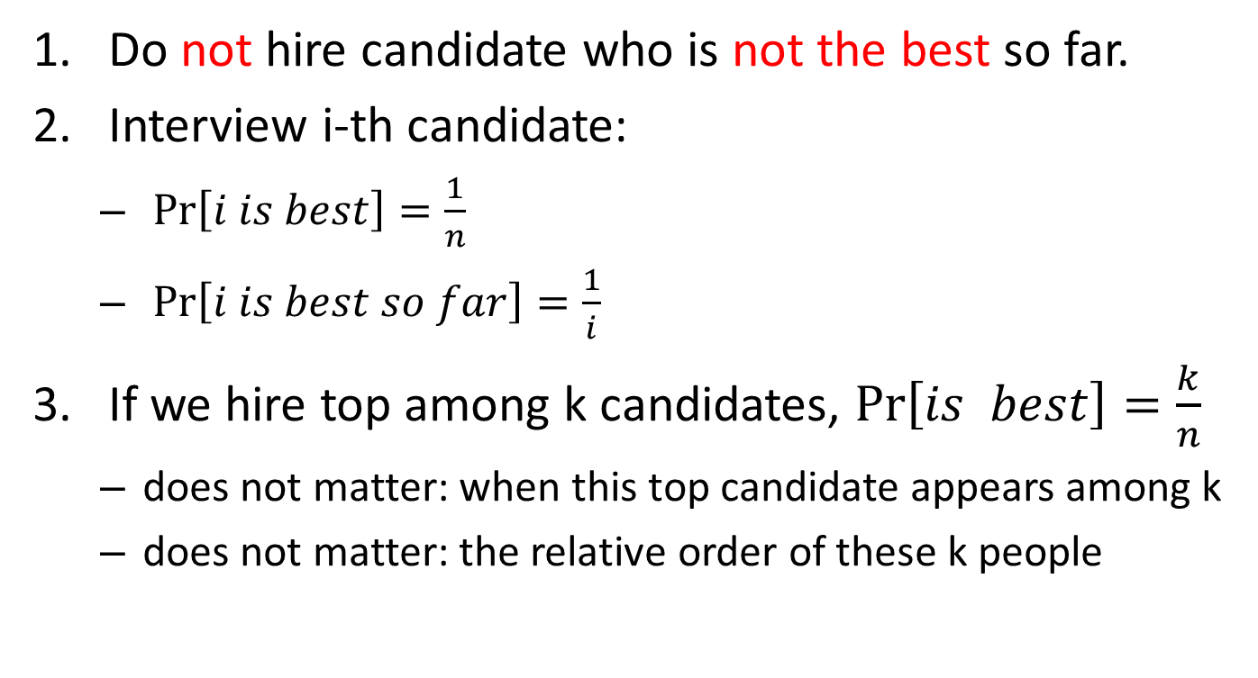
Observations
Do not hire candidate who is not the best so far.
Interview i-th candidate:
  $\operatorname{Pr}\left[i is best\right]=\frac{1}{n}$
  $\operatorname{Pr}\left[i is best so far\right]=\frac{1}{i}$
If we hire top among k candidates, $\operatorname{Pr}\left[is best\right]=\frac{k}{n}$
  does not matter: when this top candidate appears among k
  does not matter: the relative order of these k people

Slide 31


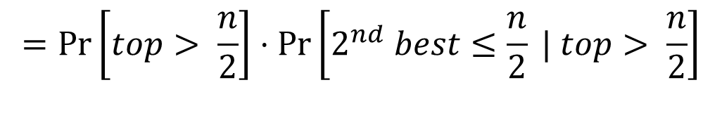
Analysis
How to achieve probability $≥\frac{1}{4}$:
Ignore first $\frac{n}{2}$ candidates
Among remaining $\frac{n}{2}$ pick any that is best so far
Exploration phase
Exploitation phase
$$\operatorname{Pr}\left[pick top\right]≥Pr⁡\left[top after\frac{n}{2} AND 2^{nd} best before \frac{n}{2}\right]$$
$$=\operatorname{Pr}\left[top> \frac{n}{2}\right]⋅\operatorname{Pr}\left[2^{nd} best≤\frac{n}{2} | top> \frac{n}{2}\right]$$
$$=\frac{1}{2}⋅\frac{1}{2}=\frac{1}{4}$$

Slide 32
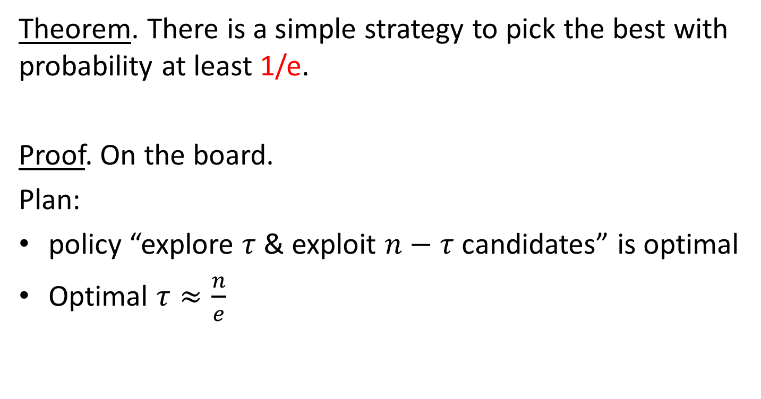
Theorem. There is a simple strategy to pick the best with probability at least 1/e.
Proof. On the board.
Plan:
policy “explore $τ$ & exploit $n−τ$candidates” is optimal
Optimal $τ≈\frac{n}{e}$

Slide 33
Sources
Lecture notes: http://www.cs.cmu.edu/~anupamg/ipco17/ipco-talk3.pdf

Slide 34
谢谢！
有问题吗？

Slide 35
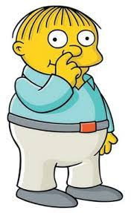
1st
2nd
3rd
<

Slide 36
1st
2nd
<

Slide 37
1st

Slide 38
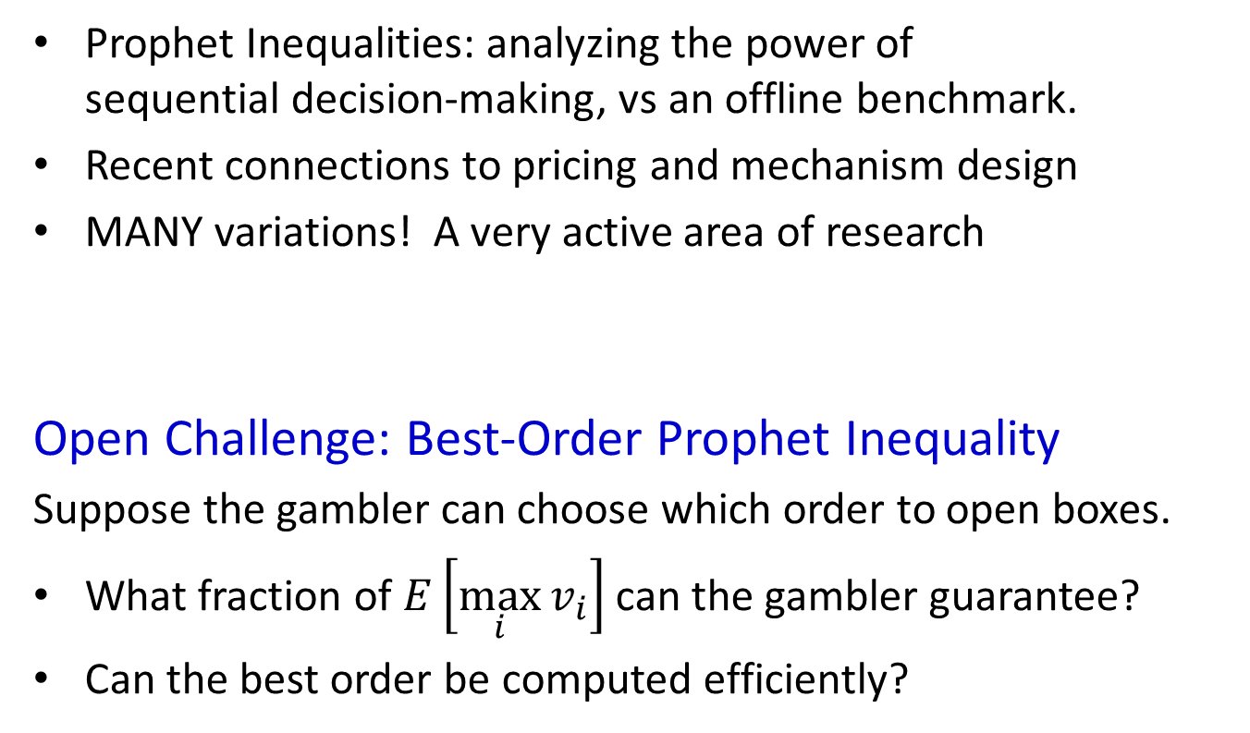
Summary
Prophet Inequalities: analyzing the power of
sequential decision-making, vs an offline benchmark.
Recent connections to pricing and mechanism design
MANY variations! A very active area of research
Open Challenge: Best-Order Prophet Inequality
Suppose the gambler can choose which order to open boxes.
What fraction of $E\left[\max_{i}{v_{i}}\right]$ can the gambler guarantee?
Can the best order be computed efficiently?
Thanks!

