Slide 1
Online Matching
Nick Gravin, ITCS SHUFE

Slide 2
Online Bipartite Matching
Offline
Vertices
Notes:
Consider a bipartite graph

Slide 3
Online Bipartite Matching
Offline
Vertices
Online
Vertices

Slide 4
Online Bipartite Matching
Offline
Vertices
Online
Vertices

Slide 5
Online Bipartite Matching
Offline
Vertices
Online
Vertices

Slide 6
Online Bipartite Matching
Offline
Vertices
Online
Vertices

Slide 7
Online Bipartite Matching
Offline
Vertices
Online
Vertices

Slide 8
Online Bipartite Matching
Offline
Vertices
Online
Vertices

Slide 9
Online Bipartite Matching
Offline
Vertices
Online
Vertices

Slide 10
Online Bipartite Matching
Offline
Vertices
Online
Vertices

Slide 11
Online Bipartite Matching
Offline
Vertices
Online
Vertices
ALG = 3

Slide 12
Online Bipartite Matching
Offline
Vertices
Online
Vertices
ALG = 3
OPT = 5

Slide 13
Online Bipartite Matching
Greedy: match each online vertex to an arbitrary unmatched neighbor (if any). Greedy is 0.5-competitive.
Observation: no deterministic algorithm can be better than 0.5-competitive.
Can we do better with randomized algorithm?

Slide 14
Ranking [Karp et al. STOC 1990]
Offline
Vertices

Slide 15
Ranking [Karp et al. STOC 1990]
3
2
Offline
Vertices
4
5
1
Random Rank

Slide 16
Ranking [Karp et al. STOC 1990]
3
2
Offline
Vertices
Online
Vertices
4
5
1
Random Rank

Slide 17
Ranking [Karp et al. STOC 1990]
Match to the adjacent & available vertex with the smallest rank
3
2
Offline
Vertices
Online
Vertices
4
5
1
Random Rank

Slide 18
Ranking [Karp et al. STOC 1990]
Match to the adjacent & available vertex with the smallest rank
3
2
Offline
Vertices
Online
Vertices
4
5
1

Slide 19
Ranking [Karp et al. STOC 1990]
Match to the adjacent & available vertex with the smallest rank
3
2
Offline
Vertices
Online
Vertices
4
5
1

Slide 20
Ranking [Karp et al. STOC 1990]
Match to the adjacent & available vertex with the smallest rank
3
2
Offline
Vertices
Online
Vertices
4
5
1

Slide 21
Ranking [Karp et al. STOC 1990]
Match to the adjacent & available vertex with the smallest rank
3
2
Offline
Vertices
Online
Vertices
4
5
1

Slide 22
Ranking [Karp et al. STOC 1990]
Match to the adjacent & available vertex with the smallest rank
3
2
Offline
Vertices
Online
Vertices
4
5
1

Slide 23
Ranking [Karp et al. STOC 1990]
Match to the adjacent & available vertex with the smallest rank
3
2
Offline
Vertices
Online
Vertices
4
5
1

Slide 24
Ranking [Karp et al. STOC 1990]
Match to the adjacent & available vertex with the smallest rank
3
2
Offline
Vertices
Online
Vertices
4
5
1
ALG = 4

Slide 25
Online Bipartite Matching
Greedy: match each online vertex to an arbitrary unmatched neighbor (if any). Greedy is 0.5-competitive.
Ranking: picks a random permutation over offline vertices, and matches each online vertex to the first unmatched neighbor.

Slide 26
Online Bipartite Matching
Greedy: match each online vertex to an arbitrary unmatched neighbor (if any). Greedy is 0.5-competitive.
Ranking: picks a random permutation over offline vertices, and matches each online vertex to the first unmatched neighbor.
Ranking is (1-1/e)-competitive, by Karp et al. [STOC 1990]
  Birnbaum and Mathieu SIGACT 2008
  Goel and Mehta SODA 2008
  Devanur, Jain and Kleinberg, SODA 2013

Slide 27
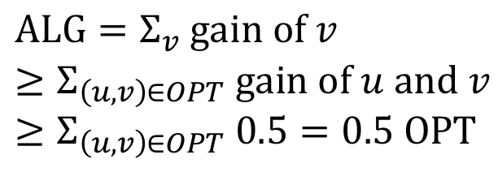
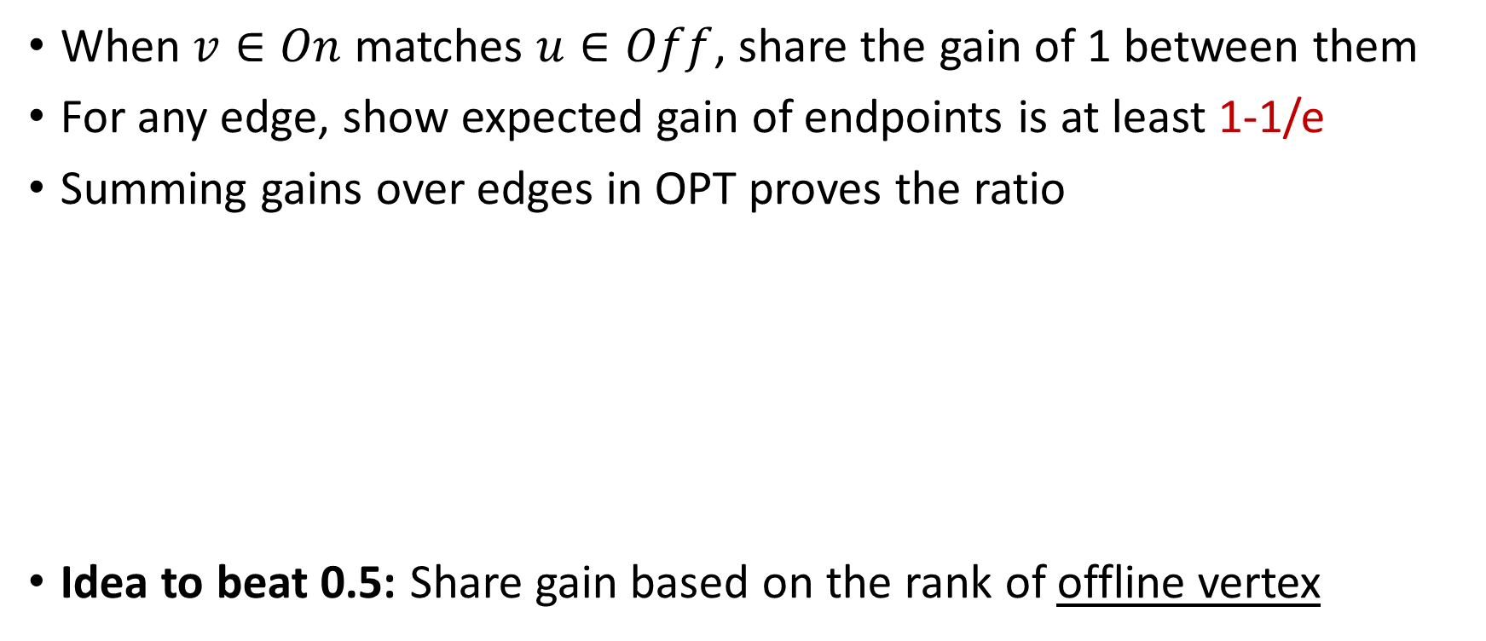
Gain Sharing
When $v∈On$ matches $u∈Off$, share the gain of 1 between them
For any edge, show expected gain of endpoints is at least 1-1/e
Summing gains over edges in OPT proves the ratio
Idea to beat 0.5: Share gain based on the rank of offline vertex
0.5
0.5
Example:
Rank top to bottom
0.5-competitive
0.5
0.5
$$ALG=Σ_{v} gain of v \\ ≥Σ_{\left(u, v\right)∈OPT} gain of u and v \\ ≥Σ_{\left(u, v\right)∈OPT} 0.5=0.5 OPT$$
0.5
0.5
0.5
0.5

Slide 28
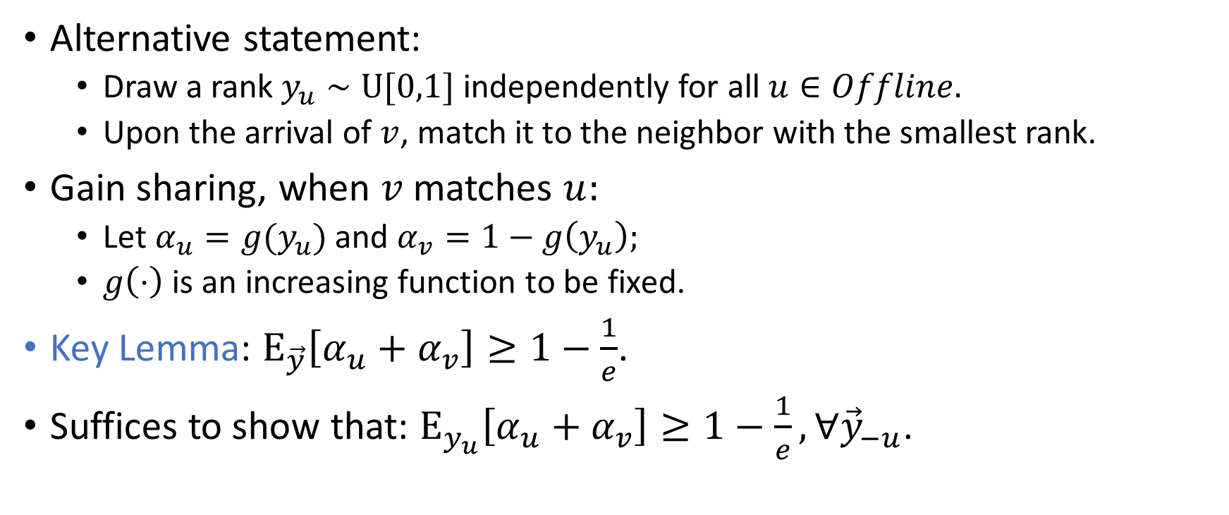
Gain Sharing
Alternative statement:
  Draw a rank $y_{u}∼U[0,1]$ independently for all $u∈Offline.$
  Upon the arrival of $v$, match it to the neighbor with the smallest rank.
Gain sharing, when $v$ matches $u:$
  Let $α_{u}=g(y_{u})$ and $α_{v}=1−g\left(y_{u}\right);$
  $g\left(⋅\right)$ is an increasing function to be fixed.
Key Lemma: $E_{\vec{y}}\left[α_{u}+α_{v}\right]≥1−\frac{1}{e}$.
Suffices to show that: $E_{y_{u}}\left[α_{u}+α_{v}\right]≥1−\frac{1}{e}, ∀{\vec{y}}_{−u}$.

Slide 29
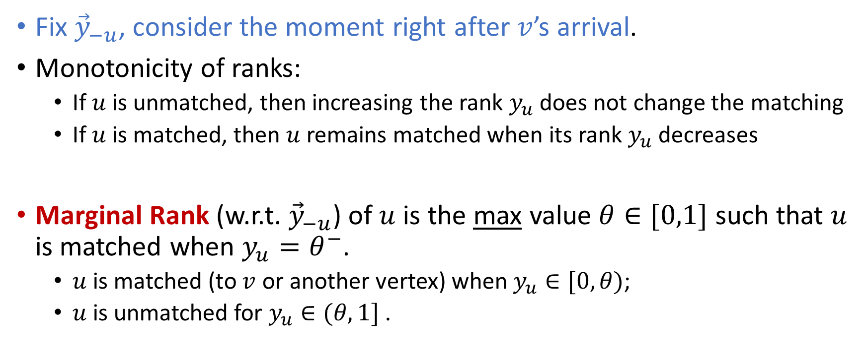
Marginal Rank
Fix ${\vec{y}}_{−u}$, consider the moment right after $v$’s arrival.
Monotonicity of ranks:
  If $u$ is unmatched, then increasing the rank $y_{u}$ does not change the matching
  If $u$ is matched, then $u$ remains matched when its rank $y_{u}$ decreases
Marginal Rank (w.r.t. ${\vec{y}}_{−u}$) of $u$ is the max value $θ∈[0,1]$ such that $u$ is matched when $y_{u}=θ^{−}$.
  $u$ is matched (to $v$ or another vertex) when $y_{u}∈[0,θ)$;
  $u$ is unmatched for $y_{u}∈(θ,1]$ .

Slide 30

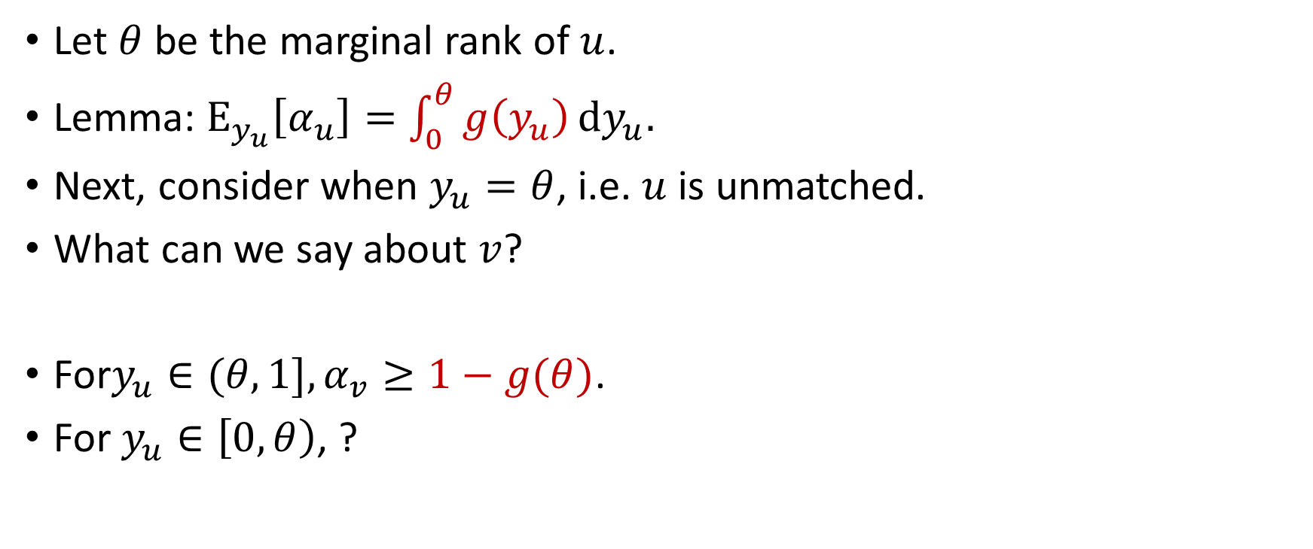
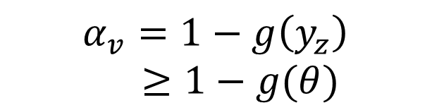


Analysis
Let $θ$ be the marginal rank of $u$.
Lemma: $E_{y_{u}}\left[α_{u}\right]=$ $\int_{0}^{θ}{g\left(y_{u}\right)}dy_{u}.$
Next, consider when $y_{u}=θ$, i.e. $u$ is unmatched.
What can we say about $v$?
For$y_{u}∈(θ,1], α_{v}≥1−g(θ)$.
For $y_{u}∈\left[0,θ\right)$, ?
?
$$v$$
$$u$$
$$z$$
$$α_{v}=1−g\left(y_{z}\right)$$
$≥1−g(θ)$

Slide 31



Alternating path
$$u$$
$$w$$
Edges in $M(\vec{y}\text{)}$

Slide 32


Alternating path
$$u$$
$$w$$
Edges in $M(\vec{y}\text{)}$
Edges in $M({\vec{y}}_{−u})$
$$z$$

Slide 33

Alternating path
$$u$$
$$w$$
Edges in $M(\vec{y}\text{)}$
Edges in $M({\vec{y}}_{−u})$
$$z$$
$$y_{z}>y_{u}$$

Slide 34

Alternating path
$$u$$
$$w$$
Edges in $M(\vec{y}\text{)}$
Edges in $M({\vec{y}}_{−u})$
$$z$$
$$y_{z}>y_{u}$$

Slide 35

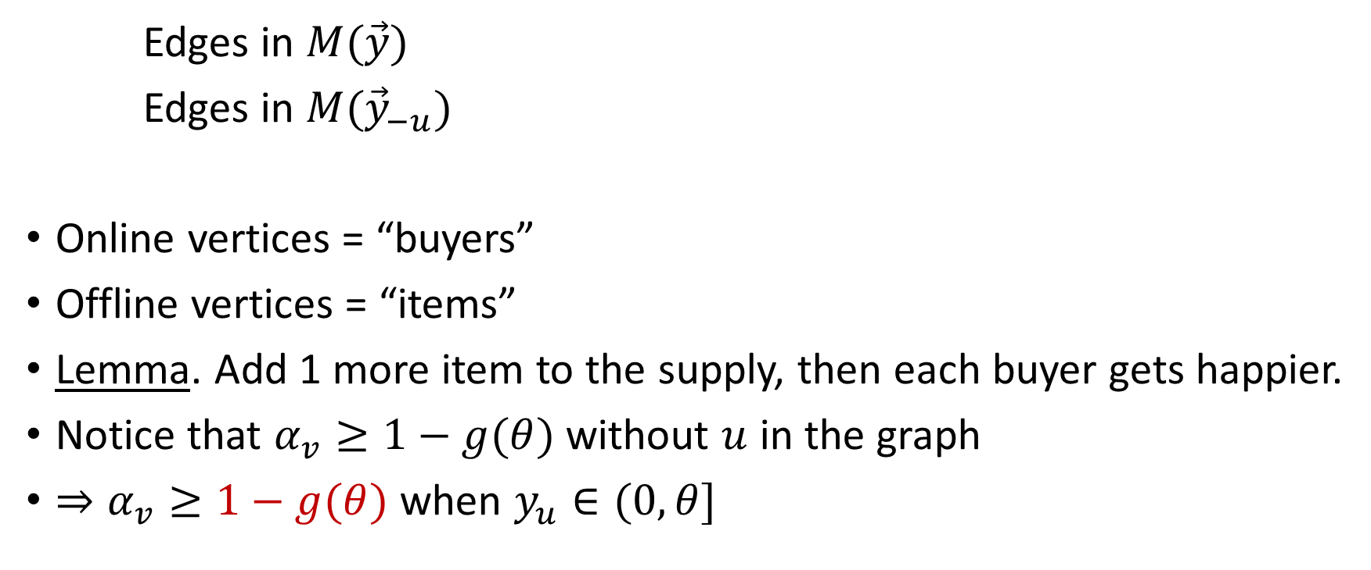
Alternating path
$$u$$
$$w$$
Edges in $M(\vec{y}\text{)}$
Edges in $M({\vec{y}}_{−u})$
Online vertices = “buyers”
Offline vertices = “items”
Lemma. Add 1 more item to the supply, then each buyer gets happier.
Notice that $α_{v}≥1−g(θ)$ without $u$ in the graph
$⇒α_{v}≥1−g(θ)$ when $y_{u}∈(0,θ]$
$$z$$
$$x$$
$$y_{z}>y_{u}$$

Slide 36
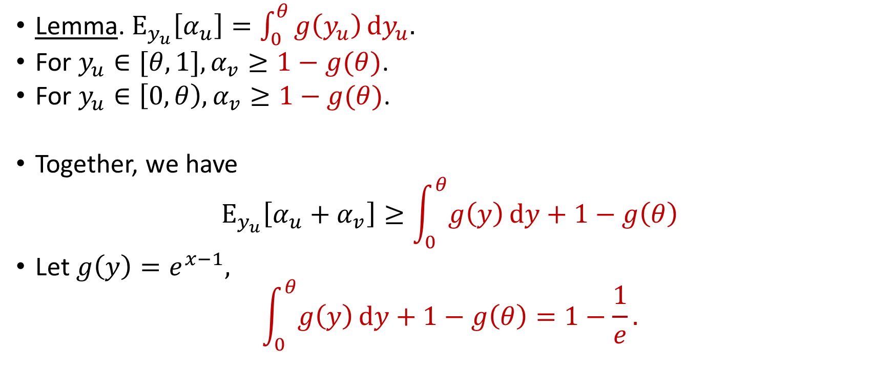
Analysis
Lemma. $E_{y_{u}}\left[α_{u}\right]=\int_{0}^{θ}{g\left(y_{u}\right)}dy_{u}.$
For $y_{u}∈[θ,1], α_{v}≥1−g(θ)$.
For $y_{u}∈\left[0,θ\right),α_{v}≥1−g(θ)$.
Together, we have
$$E_{y_{u}}\left[α_{u}+α_{v}\right]≥\int_{0}^{θ}{g\left(y\right)}dy+1−g\left(θ\right)$$
Let $g\left(y\right)=e^{x−1},$
$$\int_{0}^{θ}{g\left(y\right)}dy+1−g\left(θ\right)=1−\frac{1}{e}.$$

Slide 37
Online Bipartite Matching
Greedy: match each online vertex to an arbitrary unmatched neighbor (if any). Greedy is 0.5-competitive.
Ranking: picks a random permutation over offline vertices, and matches each online vertex to the first unmatched neighbor.
Ranking is (1-1/e)-competitive, by Karp et al. [STOC 1990]
  A matching lower bound.

Slide 38
Online Bipartite Matching
Greedy: match each online vertex to an arbitrary unmatched neighbor (if any). Greedy is 0.5-competitive.
Ranking: picks a random permutation over offline vertices, and matches each online vertex to the first unmatched neighbor.
Ranking is (1-1/e)-competitive, by Karp et al. [STOC 1990]
  A matching lower bound.
  Same competitive ratio for vertex-weighted case: Aggarwal et al. [SODA 2011]

Slide 39
Online Bipartite Matching
Greedy: match each online vertex to an arbitrary unmatched neighbor (if any). Greedy is 0.5-competitive.
Ranking: picks a random permutation over offline vertices, and matches each online vertex to the first unmatched neighbor.
Ranking is (1-1/e)-competitive, by Karp et al. [STOC 1990]
  A matching lower bound.
  Same competitive ratio for vertex-weighted case: Aggarwal et al. [SODA 2011]
  Better competitive ratios for random arrivals: 0.653 by Karande et al. [STOC 2011] and 0.696 by Mahdian and Yan [STOC 2011].

